Slide 2



Don’t Open Row: Rethinking
Row Buffer Policy for Improving
Performance of Non-Volatile Memories
Yongho Lee, Osang Kwon and Seokin Hong

Slide 3
Background

Slide 4

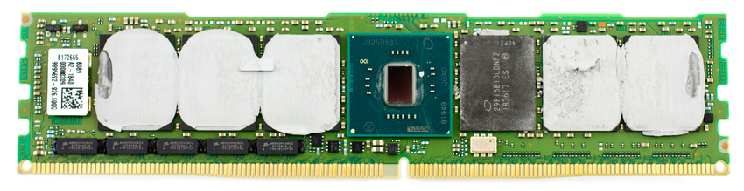
PCM (Phase Change Memory)
Background
Non-volatile
High capacity
Low power
Possible DRAM replacement
Intel Optane DC Persistent Memory Module¹
¹Brian Beeler, StorageReview, April 2, 2019

Slide 5
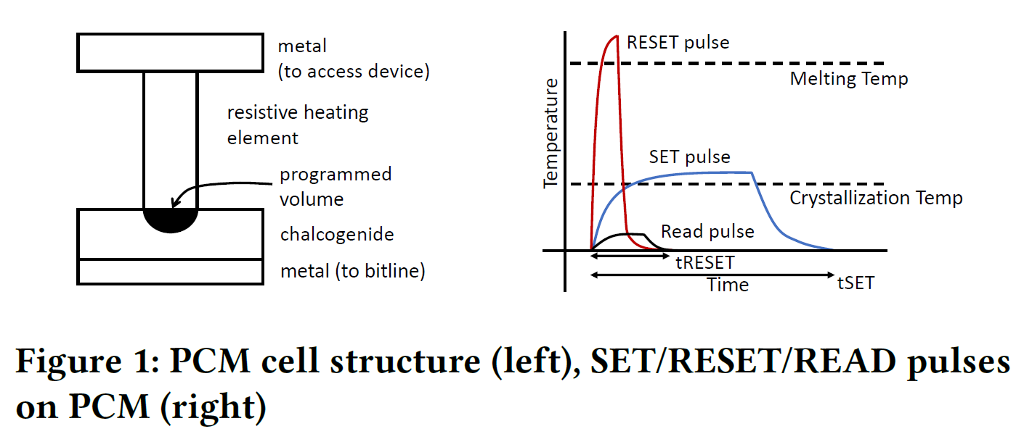
PCM (Phase Change Memory)
Background
RESET(bit ‘0’) : Short duration, High electrical pulse
SET(bit ‘1’) : Long duration, Low electrical pulse
The speed of the write operation is much slower than that of the read operation

Slide 6
PCM Architecture & Operations
Background
Read Operation
1. Activation
wordline
2. Read
row activate
row-decoder
row-decoder
bitline
Row-Data
row-addr
Chip
write-driver
row-buffer
row-buffer
Data

Slide 7
PCM Architecture & Operations
Background
Write Operation
1. Activation
wordline
2. Write
row activate
row-decoder
row-decoder
bitline
Row-Data
row-addr
Chip
write-driver
write-driver
row-buffer
row-buffer
Data

Slide 8
Major Hurdle: Slow PCM Operations
Background
Row activation latency (tRCD) and Write latency (tWR) are much longer than others
Read
ACT
RD
PRE
ACT
tRCD
tRCD
Write
ACT
WR
PRE
ACT
tRCD
tBURST + tWR
tRCD
tBURST + tWR
Row activation and write operation are major bottlenecks limiting the performance of PCM systems

Slide 9
Row Buffer Policy
Background
Open-page Policy
  Keeps the row data in the row buffer until another row is activated (i.e., bank conflict occurs)
Close-page Policy
  Closes the activated row immediately after the subsequent read or write request is serviced on the activated row
Both policies cannot hide the long activation latency if the row buffer locality is low

Slide 10
Write Scheme
Background
Write-Back
  Data is only written to the row buffer, then written back to PCM cells when closing the open row
  → Fast writes on row buffer hit
  When a bank conflict occurs, the data in the row buffer has to be written back to PCM cells
  → High bank conflict overhead
open row
row-decoder
row-decoder
row-addr
write-driver
write-driver
row-buffer
row-buffer
Data

Slide 11
Write Scheme
Background
Write-Through
  Data is written to both row buffer and PCM cells at the same time
  When a bank conflict occurs, the open row can be immediately closed
  → Low bank conflict overhead
open row
row-decoder
row-decoder
row-addr
write-driver
write-driver
row-buffer
row-buffer
Data
Both policies require the slow row activation

Slide 12
Problem:
Row activation latency is a major bottleneck in PCM systems
Limitation of Current Mechanisms:
Conventional row buffer policies and write schemes cannot address this problem.
Our goal: Mitigating slow row activation in PCM systems

Slide 13
Motivation

Slide 14
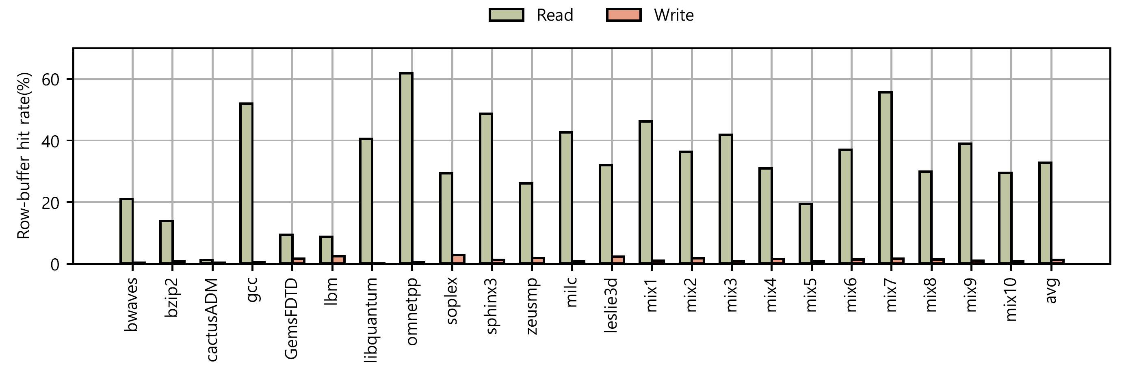
Poor Locality of Write Requests
Motivation
Average row-buffer hit rate of read requests : 32%
Average row-buffer hit rate of write requests : 1%
The write requests have poor row buffer locality

Slide 15
Non-destructive ACT in PCM
Motivation
Plate
Row activation destroys data stored in the DRAM cells
To restore destructed data, the activated row should be latched by the sense amplifier(row buffer)
Destroyed!
Restored!
Capacitor
Wordline
Bitline
S/A
DRAM

Slide 16
Non-destructive ACT in PCM
Motivation
Plate
Bitline
Row activation does not destroy data stored in the PCM cells
Latching activated row in row buffer is not necessary
Restored!
Capacitor
Not Destroyed!
Resistive
Storage
Wordline
Wordline
Bitline
S/A
DRAM
PCM¹
¹Lu, Shyue-Kung, et al., Journal of Electronic Testing 37.4, 2021

Slide 17
Non-destructive ACT in PCM
Motivation
Plate
Bitline
Non-destructive property enables the separation of the row activation operation into two sub-operations in the PCM systems:
wordline
Resistive
Storage
Capacitor
fetching data
Wordline
row-decoder
Wordline
row-addr
bitline
Data
Bitline
DRAM
row-buffer
PCM¹
Decoding row address
+ Fetching data to the row buffer
¹Lu, Shyue-Kung, et al., Journal of Electronic Testing 37.4, 2021

Slide 18
Write-Around PCM System

Slide 19
Key Idea
Write-Around PCM System
Write-Around PCM system does not fetch data to the row buffer for write requests
Instead, it only drives a wordline to connect PCM cells in the target row to bitlines
When a write request is issued, the given data is directly written to the PCM cells
To apply Write-Around scheme to the PCM systems,
we propose Pseudo Row Activation and Direct Write

Slide 20
Pseudo Row Activation
Write-Around PCM System
7.5ns(13%)
Conventional row activation (ACT)
  The entire PCM cells of the target row are connected to bitlines
  Fetch the data stored in the target row into the row buffer
  Fetching the data accounts for the majority of row activation latency.
wordline
open row
row activate
row-decoder
bitline
row-addr
Data
48ns(87%)
row-buffer

Slide 21
Pseudo Row Activation
Write-Around PCM System
7.5ns(13%)
Pseudo row activation (P-ACT)
  Does not fetch the data stored in the target row
  Just drives the wordline of the target row
  P-ACT reduces the row activation latency by 87%
wordline
pseudo-
open row
row activate
row-decoder
row-addr
bitline
row-buffer

Slide 22
Direct Write
Write-Around PCM System
wordline
direct write
Writes data directly to the pseudo-open row
  PCM cells of the pseudo-open row are connected to the bitlines
  So, data can be written directly to the pseudo-open row by injecting proper write pulses to the bitlines
row-decoder
row-addr
bitline
data
75ns
write driver
write driver
row-buffer

Slide 23
Write-Around PCM system
Write-Around PCM System
Write-Back
ACT
WR
PRE
ACT
RD
RD
Write-Back : tRCD + tBURST + tWR + tRP + tRCD
Write-Around : tPRCD + tBURST + tWR + tRP + tRCD
tPRCD is much shorter than tRCD
tRCD
tBURST + tWR
tRP
tRCD
Write-Around
P-ACT
WR
PRE
ACT
RD
RD
tPRCD
tBURST + tWR
tRP
tRCD
speedup

Slide 24
Implementation
Write-Around PCM System
Clock
Addr
Row
Col
Bank
The PCM controller for Write-Around PCM systems
  1. issues Pre-ACT command first when activating a row
  2. then sends ACT command
Pre-ACT can be encoded by using the RFU (Reserved for future use) slot existing in the DDR4 or DDR5 specification
Cmd
Pre-ACT
ACT
WR
PRE
Data
P-ACT
D1
D2
D3
D4
D5
D6
D7
D8
tCMD
tPRCD
tWL
tBURST + tWR

Slide 25
Evaluation

Slide 26
Evaluation Methodology
Evaluation
Component | Configuration
Processor | 3GHz, x86 4Cores
Caches | L1 : I/D 32KB, 8 way, 4-cycle, private L2 : 4MB, 16way, 12-cycle, shared
Memory controller | FR-FCFS, 32 entries queue, Open page policy (for baseline) Pseudo-open page policy (for Ours)
Main memory | 400 MHz, 8GB, 2KB buffer, 1 channels, 2 rank / channels, 8 bank / rank
Memory timing parameters | tRCD 60ns, tWR 75ns, tCWD 10ns, tPRCD 10ns
Simulation infrastructure
  GEM5
  NVMain
Benchmark
  SPEC CPU 2006
Competitive techniques
  WB-PCM, WT-PCM

Slide 27
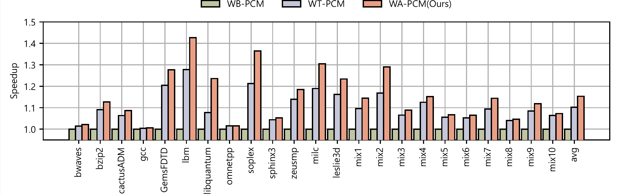
Performance Result
Evaluation
Average speedup of 15% over the WB-PCM, 4% over the WT-PCM
For 12 of 23 workloads, 24% over the WB-PCM, 7% over the WT-PCM

Slide 28
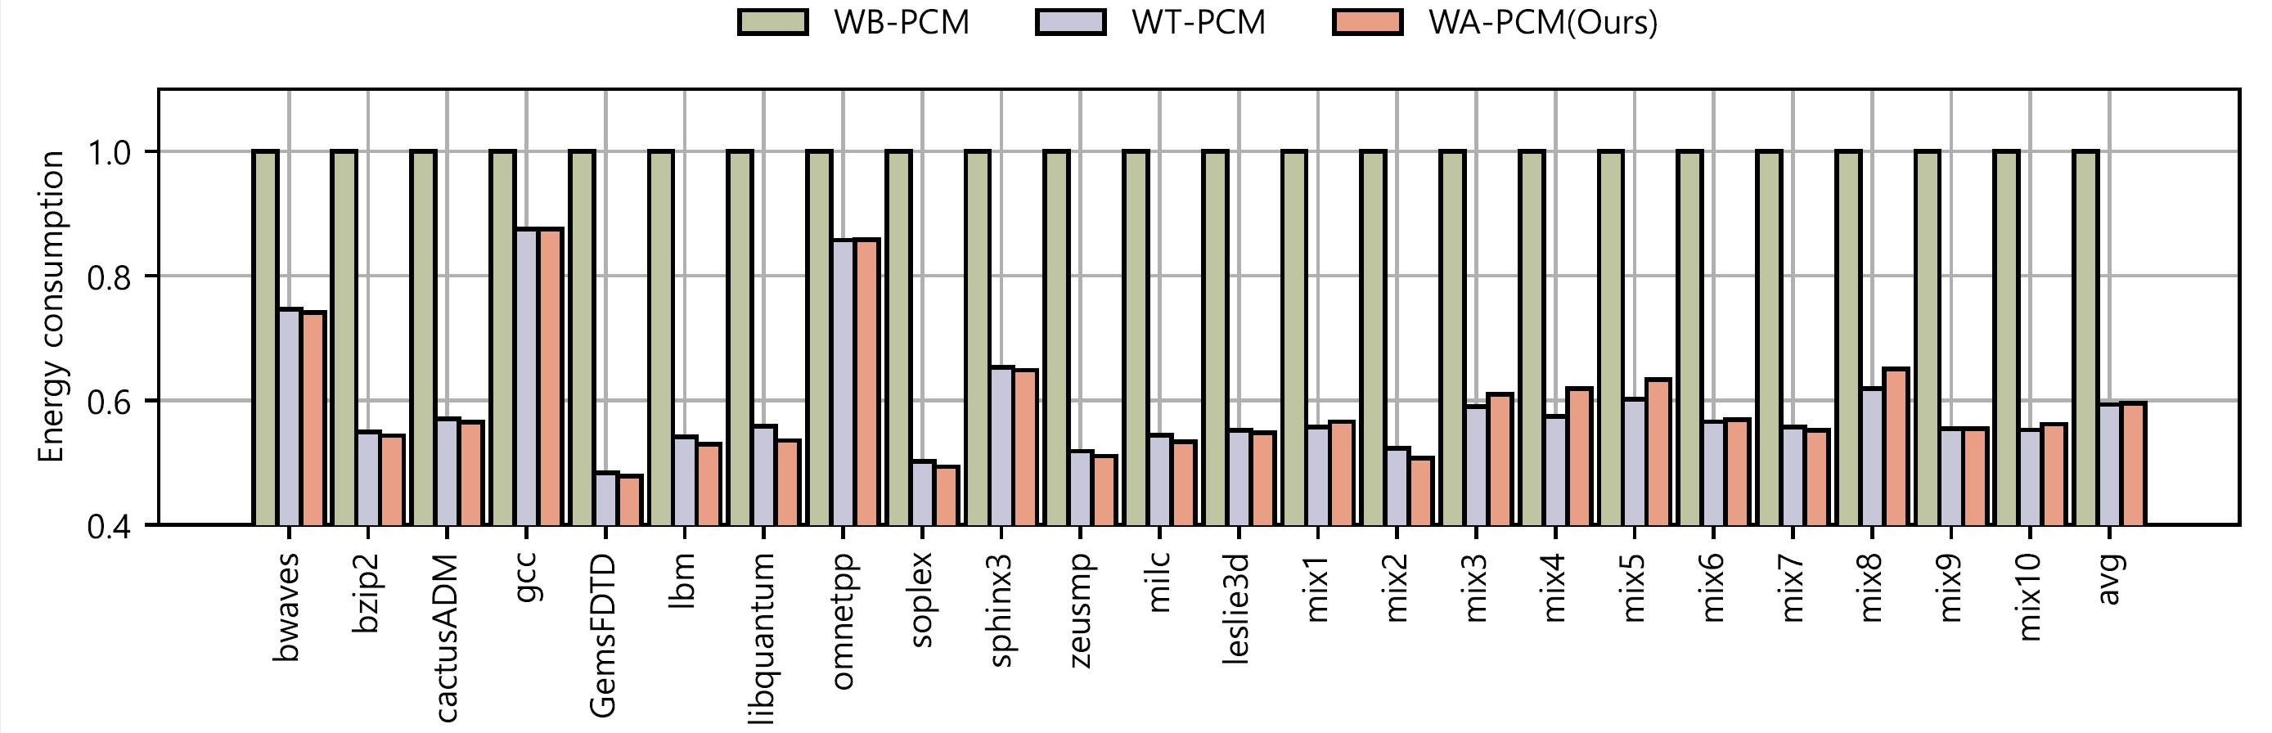
Energy Result
Evaluation
WA-PCM consumes 41% less energy than WB-PCM
For 12 of 23 workloads, consumes 47% less energy on average
Similar energy consumption to WT-PCM

Slide 29
Conclusion
The demands for scalable memory systems are increasing
  PCM systems have attracted significant attention as an alternative to DRAM
  But, the performance of PCM systems is still much lower than DRAM
Write-Around PCM system → Reduces the row activation latency
  Pseudo Row Activation + Direct Write
15% Performance gain over the WB-PCM (4% over the WT-PCM)
41% Energy reductions over the WB-PCM (similar to the WT-PCM)

Slide 30
Thank You

