Slide 1
Conveyor: Towards Asynchronous Dataflow in Systolic Array to Exploit Unstructured Sparsity
Seongwook Kim, Gwangeun Byeon, Sihyung Kim, Hyungjin Kim, Seokin Hong
Department of Electrical and Computer Engineering,
Sungkyunkwan University,
Suwon, Korea
Presenter: Seongwook Kim

Slide 2
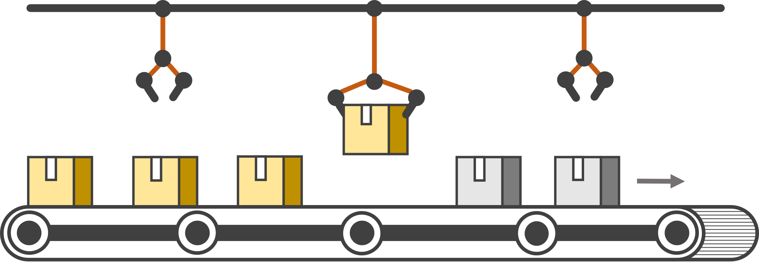
Contents
Background
  Sparsity Exploitation
  Limitations of Conventional Sparse-DNN Accelerators
  PE Underutilization Issue
Motivation
  Chunk Propagation and Load Imbalance
  Asynchronous Dataflow in Systolic Array
  Operand Queue
Conveyor-SA Architecture
  What is Conveyor Queue?
  Asynchronous Dataflow with Conveyor Queue
  Conveyor-SA Architecture
Evaluation
  Methodology
  Performance Evaluation
  Hardware Overhead
Conclusion

Slide 3
Background

Slide 4
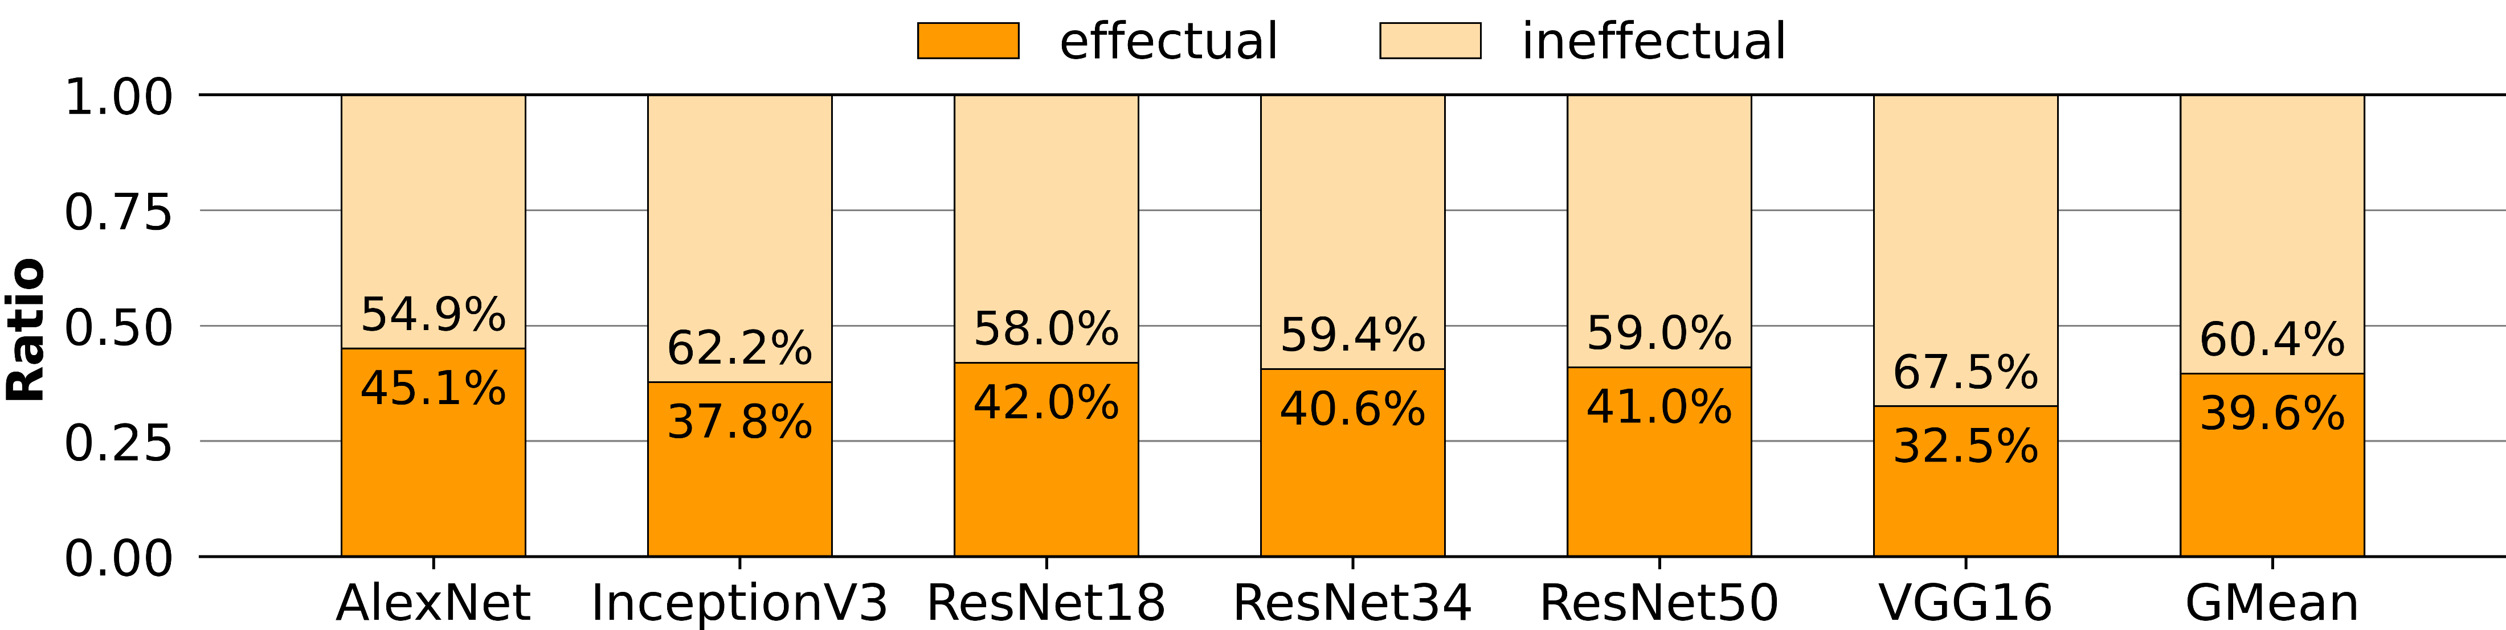
Sparsity Exploitation
DL workloads show high sparsity
Zero values generate a large number of ineffectual computations
About 60% of the total computations are ineffectual
Ratio of effectual/ineffectual computations of CNN workloads

Slide 5
Limitations of Conventional Sparse-DNN Accelerators
Systolic Array-like architecture
  Static Dataflow
  (+) Low hardware overhead
  (-) Hard to skip ineffectual computations
Accelerator with Flexible Networks
  Flexible Dataflow
  (+) Assigns only effectual computations
  (-) High hardware overhead
Activation Buffer
Unified Buffer
PE
PE
Distribution
Network
PE
PE
PE
PE
Weight Buffer
PE
PE
Reduction
Network
Nonzero
Zero

Slide 6
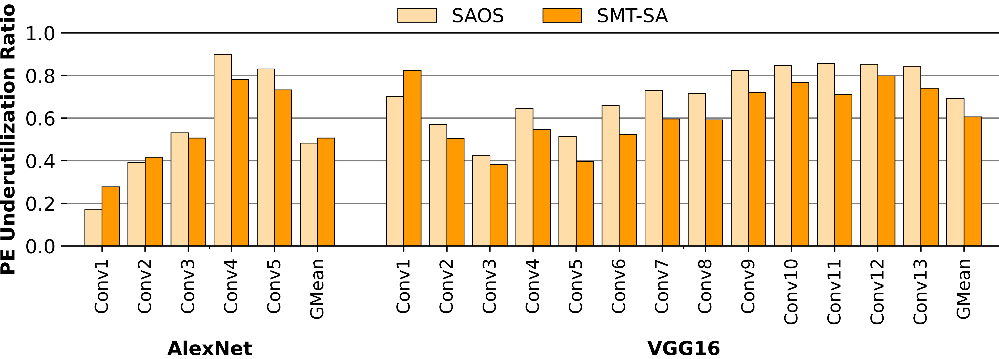
PE Underutilization Issue
Systolic Array has static dataflow → Zero values needs to be propagated
PE Underutilization: PEs with zero values must be underutilized
About 55% of the PEs are underutilized
PE underutilization of Systolic Array architectures

Slide 7
Motivation

Slide 8
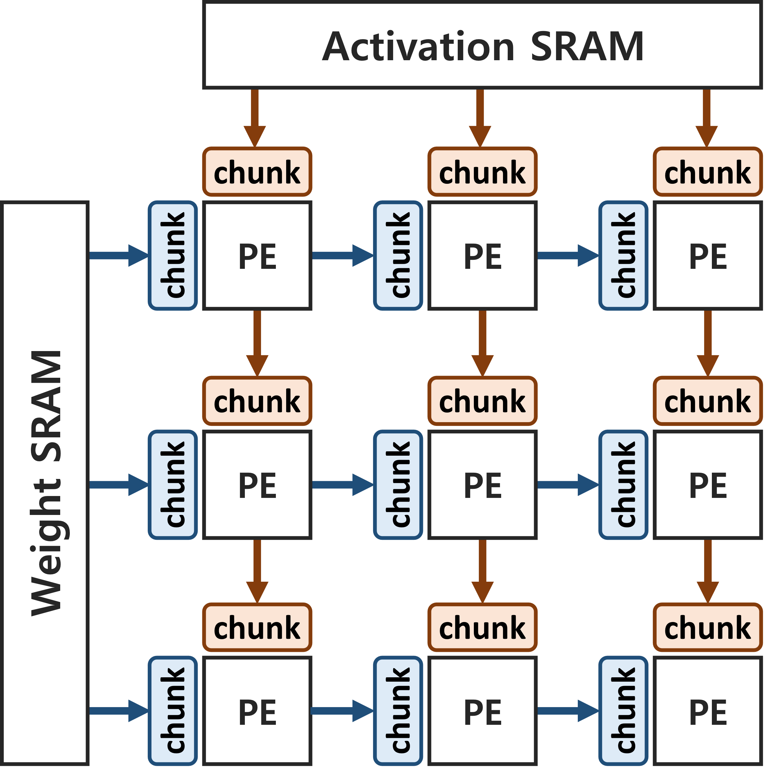
Chunk Propagation and Load Imbalance Issue
Propagate data chunks through the PE array instead of a single value
PE extracts valid operand pairs from the data chunks → Sparsity Exploitation
Speed differences between adjacent PEs → Load Imbalance
pair 0
pair 1
pair 2
activation
chunk
8
0
2
4
0
0
7
0
weight
chunk
5
3
4
0
0
3
2
6
cycle 2
cycle 1
cycle 3
3 valid operand pairs = 3 computation cycles

Slide 9
Asynchronous Dataflow in Systolic Array
Synchronous → Fast PE waits until slow neighbor finishes current task
Asynchronous → Fast PE can move on to the next task right after it finishes its current task
Asynchronous dataflow relieves PE underutilization caused by the load imbalance issue
slow
fast
slow
PE
stall
PE
stall
PE
Sync. Dataflow
slow
fast
slow
PE
PE
PE
Async. Dataflow

Slide 10
Operand Queue
Operand Queue: FIFO buffer between the adjacent PEs
  (+) Fast PE can transfer data to the Operand Queue even though the succeeding PE is still busy
  (-) Ineffective for slow-fast relationship scenario
  (-) Huge hardware overhead
fast
Operand Queue
slow
slow
Operand Queue
fast
PE
(producer)
PE
(consumer)
PE
(producer)
PE
(consumer)
stall
data
data
Scenario 1: fast-slow relationship
Scenario 2: slow-fast relationship

Slide 11
Conveyor-SA Architecture

Slide 12
What is Conveyor Queue?
Conveyor Queue distributes data chunks to the PEs
PE dynamically selects unused data chunk from its own search window
PE does not directly transfer data chunk to the adjacent PE
Conveyor Queue propagates data only if all the PEs are having data chunks to be transferred
Search Window
Search Window
PE
PE
PE
unused data chunk
used data chunk
unused workloads
used workloads
Conveyor Queue
Conveyor Belt

Slide 13
Asynchronous Dataflow with Conveyor Queue
Each PE independently fetches data chunk from its own search window
Search window of adjacent PEs are overlapping with each other
chunk 5
fast
chunk 6
PE
chunk 4
chunk 4
search window
chunk 5
chunk 3
chunk 3
chunk 4
chunk 2
Conveyor Queue
shared
region
chunk 3
chunk 4
slow
chunk 2
PE
chunk 1
chunk 3
search window
chunk 2
chunk 0
chunk 2
chunk 1

Slide 14
Asynchronous Dataflow with Conveyor Queue
Each PE independently fetches data chunk from its own search window
Search window of adjacent PEs are overlapping with each other
Conveyor Queue provides asynchronous dataflow
chunk 5
slow
chunk 6
PE
chunk 4
search window
chunk 5
chunk 3
chunk 3
chunk 4
chunk 2
Conveyor Queue
shared
region
chunk 3
chunk 4
fast
chunk 2
PE
chunk 3
chunk 1
chunk 3
search window
chunk 2
chunk 0
chunk 2
chunk 1

Slide 15
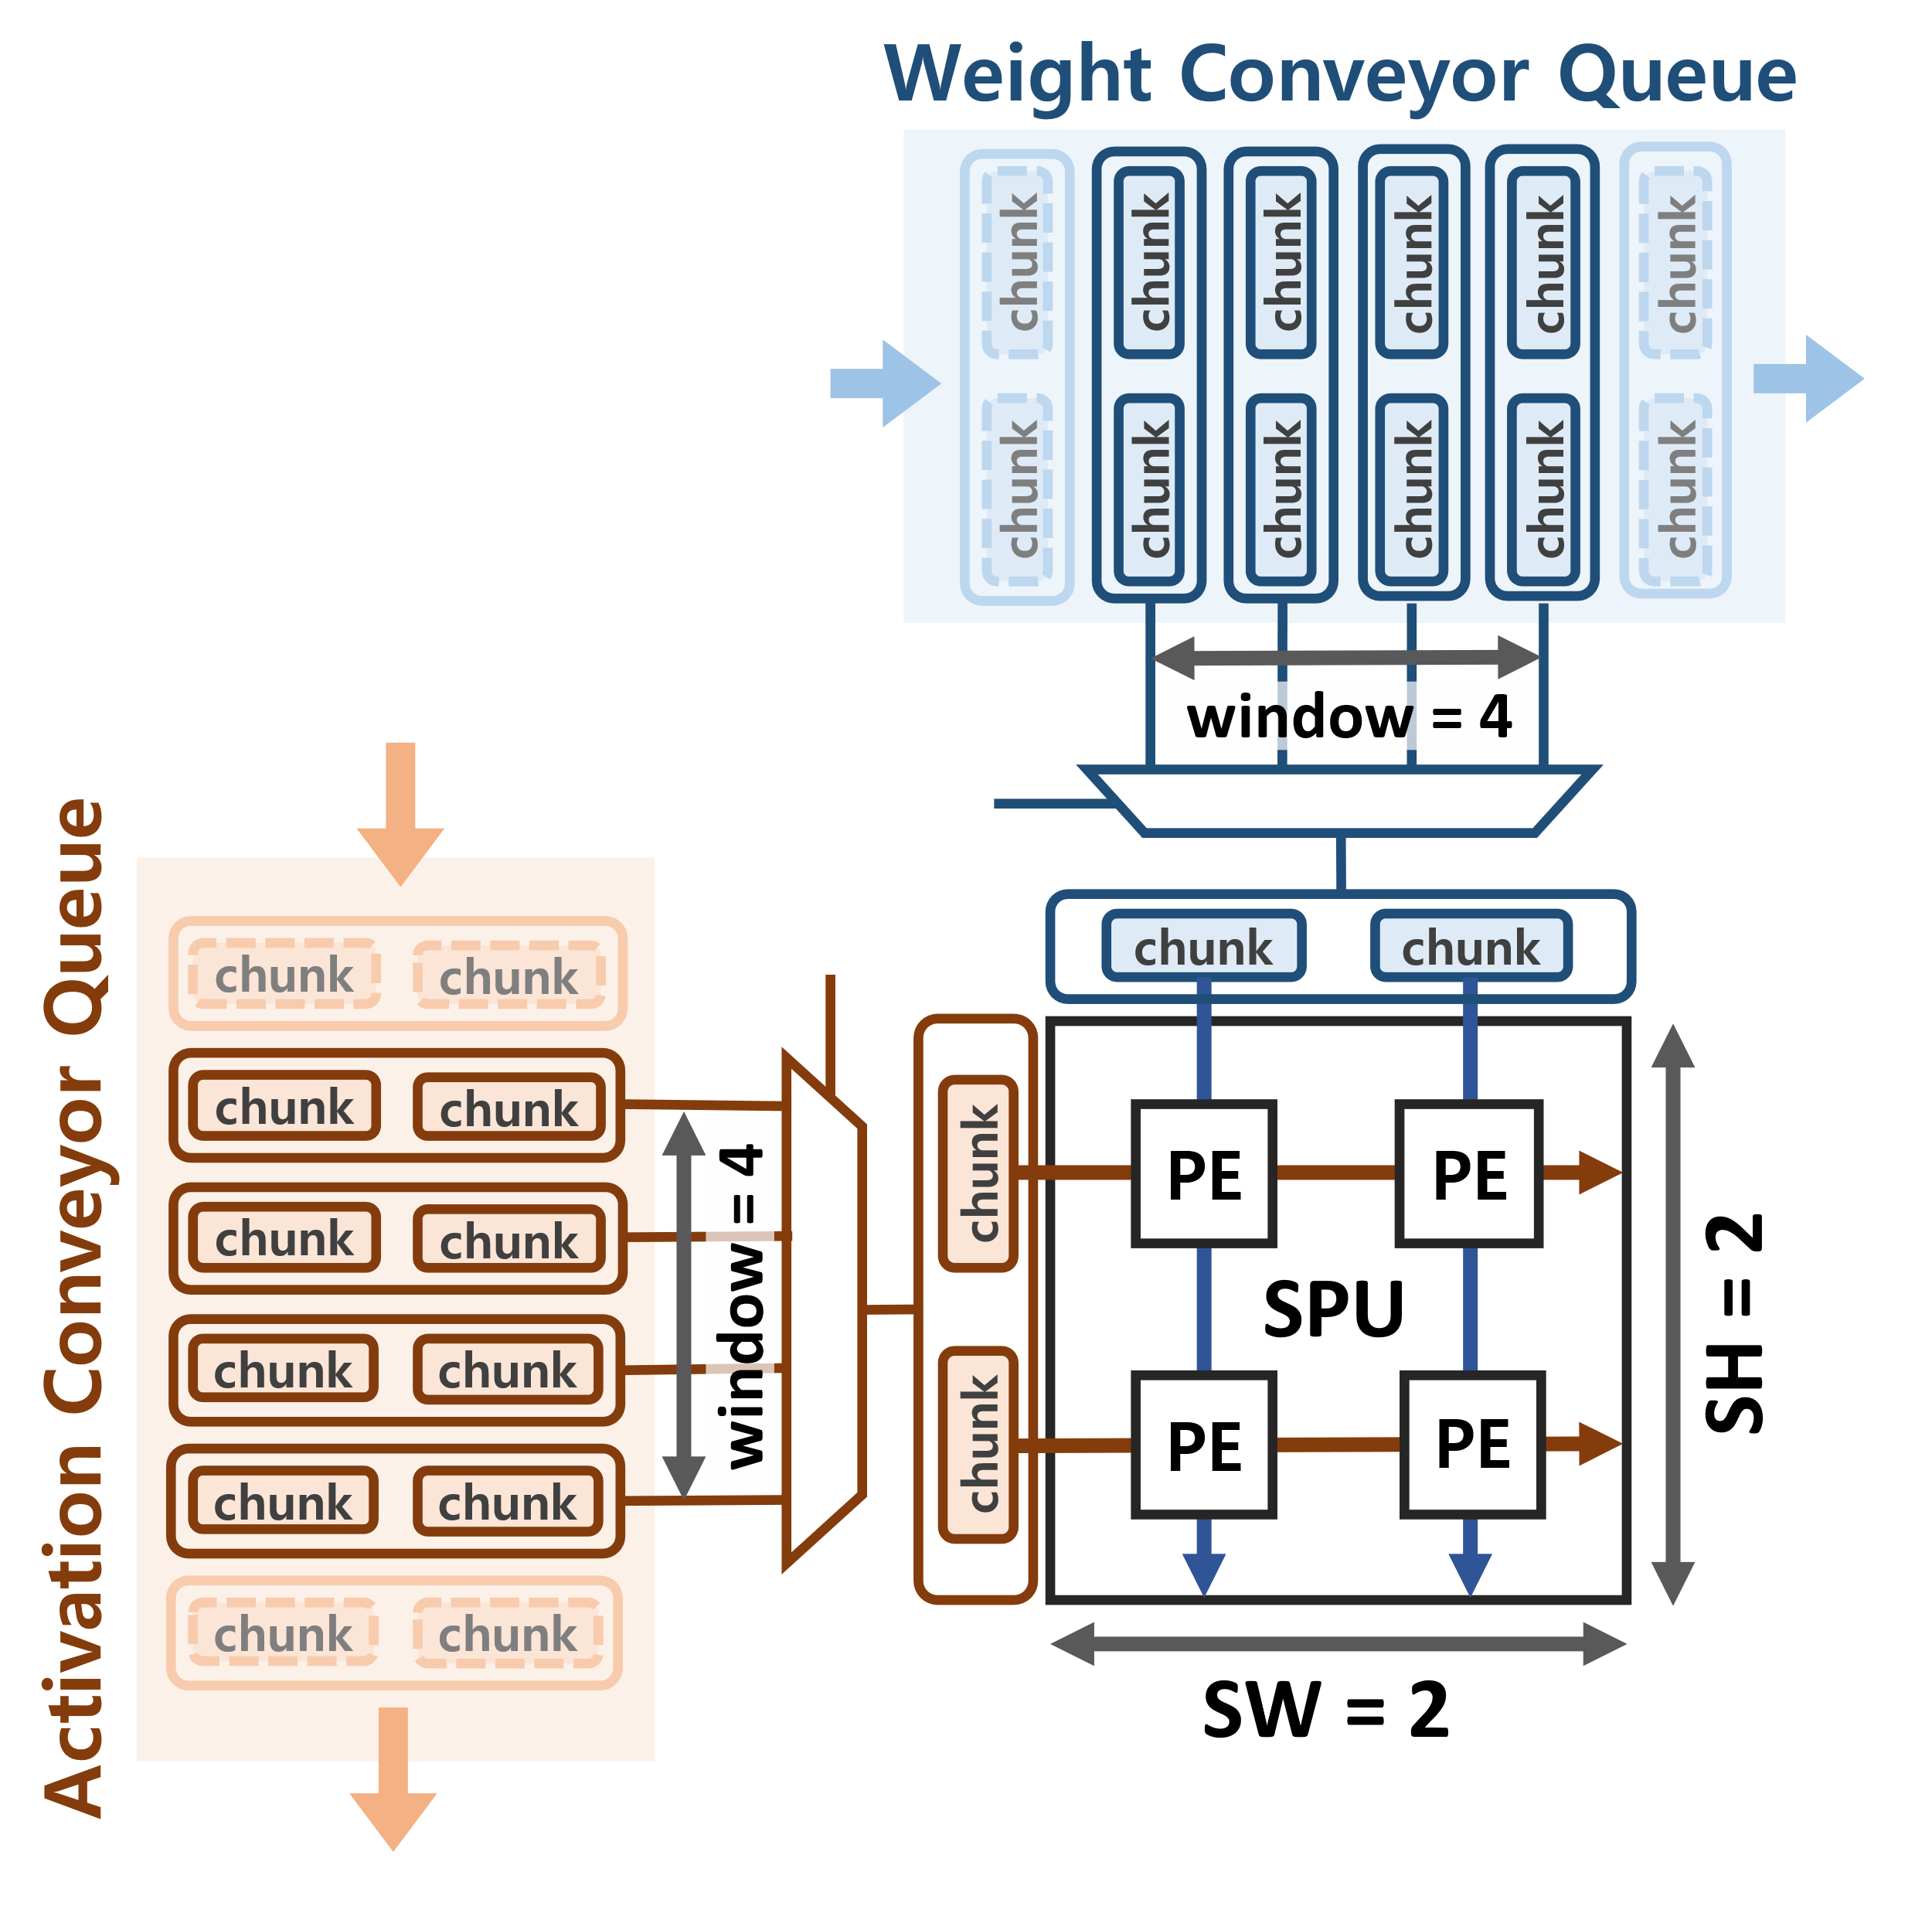
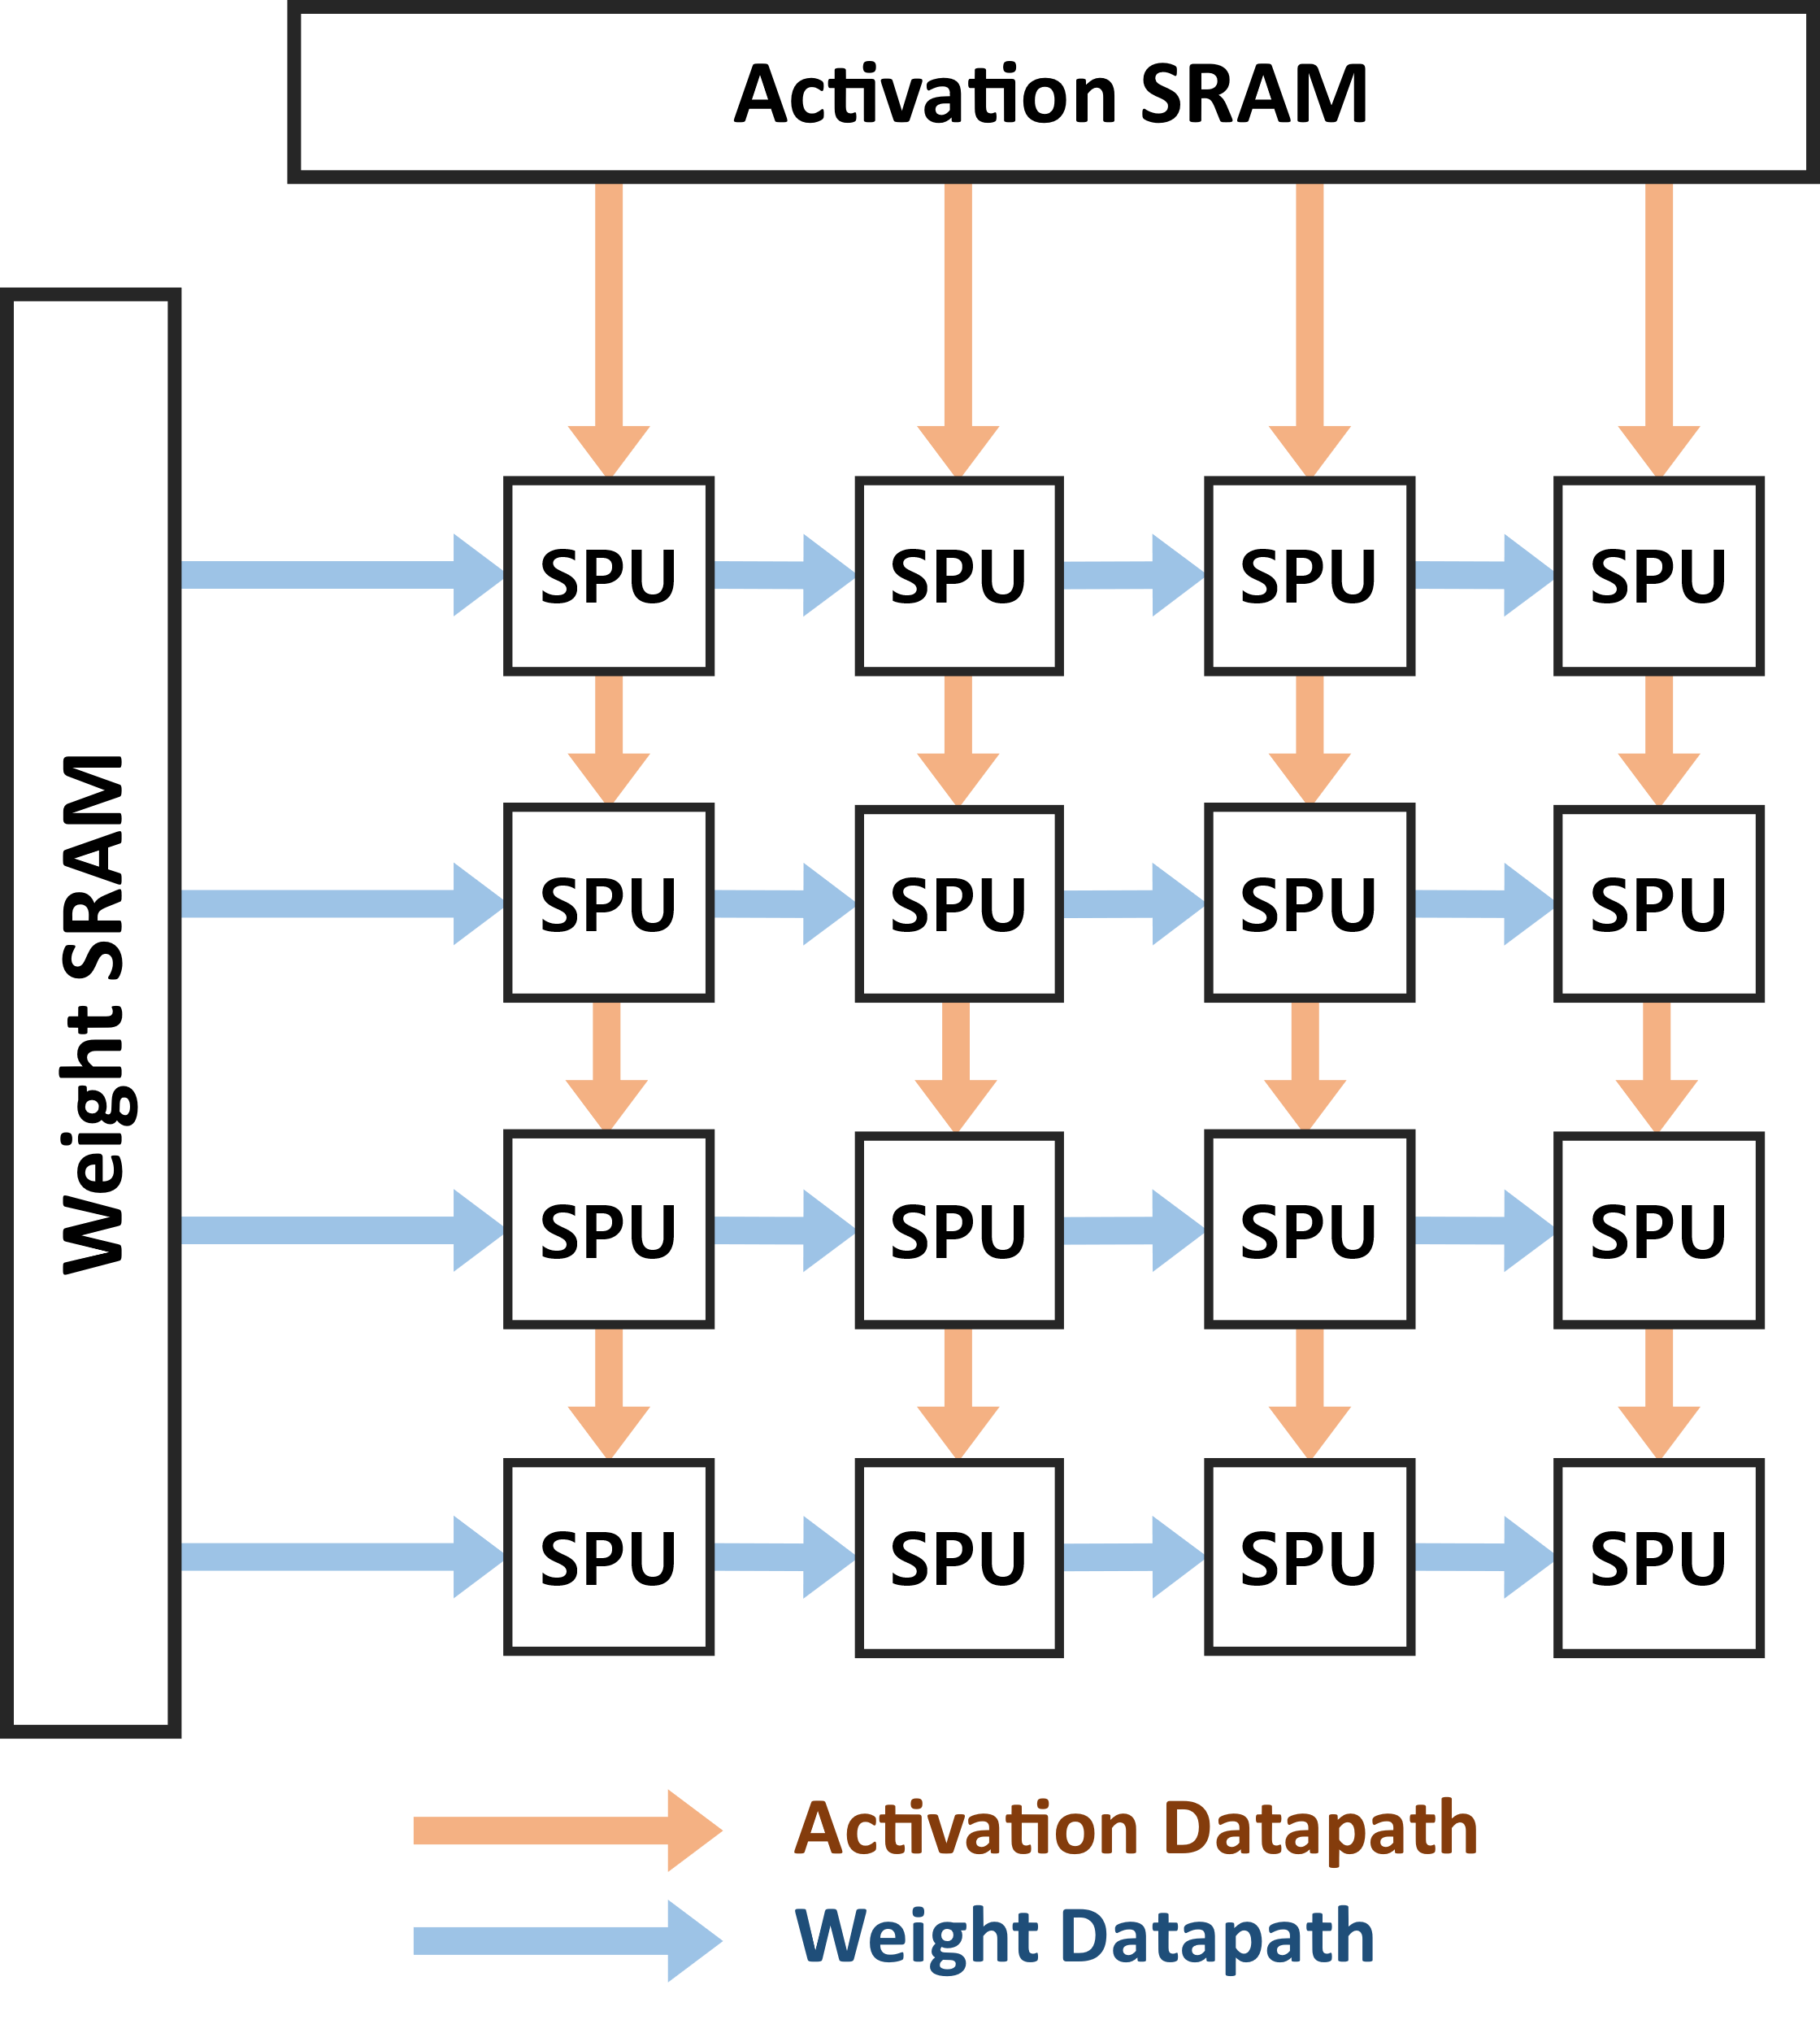
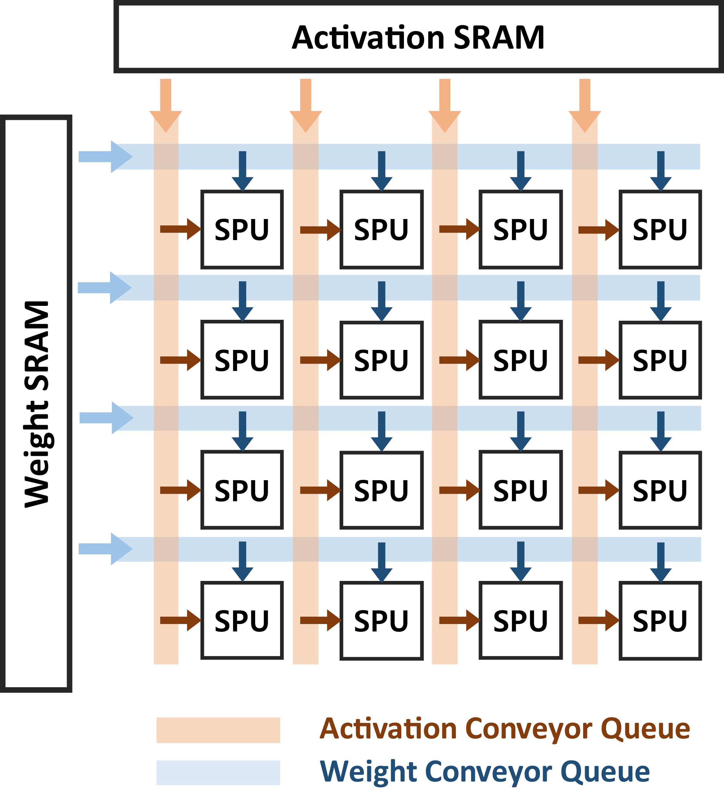
Conveyor-SA Architecture
2D pipeline is replaced with a mesh composed of Conveyor Queues
SPU (Synchronous Processing Unit): Cluster of PEs sharing the same data chunks
Weight and activation data are propagated through the Conveyor Queue
SPU dynamically selects data chunk from its own search window

Slide 16
Conveyor-SA Architecture
Read pointer (red arrow) is directed towards the data chunk currently being used
Read pointer indicates whether for the SPU to request a new data chunk
  Conveyor Controller propagates data chunks only if all the SPU requests new chunk
  Conveyor Controller send response to guarantee the read pointer is directed to the same data chunk
Conveyor Queue
Conveyor Queue
chunk group 5
chunk group 4
chunk group 3
chunk group 2
chunk group 1
chunk group 0
chunk group 8
chunk group 7
chunk group 6
chunk group 5
chunk group 4
chunk group 3
chunk group 2
chunk group 1
chunk group 0
SPU
SPU0
SPU1
SPU2
SPU3
shift trigger
shift response
request
response
request
response
request
response
request
response
request
response
Conveyor Controller
Conveyor Controller

Slide 17
Evaluation

Slide 18
Methodology
Baseline Architectures
  Conventional Systolic Array with Output Stationary Dataflow (SAOS)
  Systolic Array with Operand Queue (SMT-SA*)
Performance Evaluation
  Cycle-level simulator of Conveyor-SA
  Workloads: CNN Inference (quantized to INT8) – AlexNet, VGG16, ResNet18/34/50
Hardware Overhead
  RTL design of the Conveyor-SA
  Synopsys Design Compiler with UMC 28nm cell library
  CACTI 7.0 for assessing SRAM buffers
* Shomron, G., Horowitz, T., & Weiser, U. (2019). SMT-SA: Simultaneous multithreading in systolic arrays. IEEE Computer Architecture Letters, 18(2), 99-102.

Slide 19
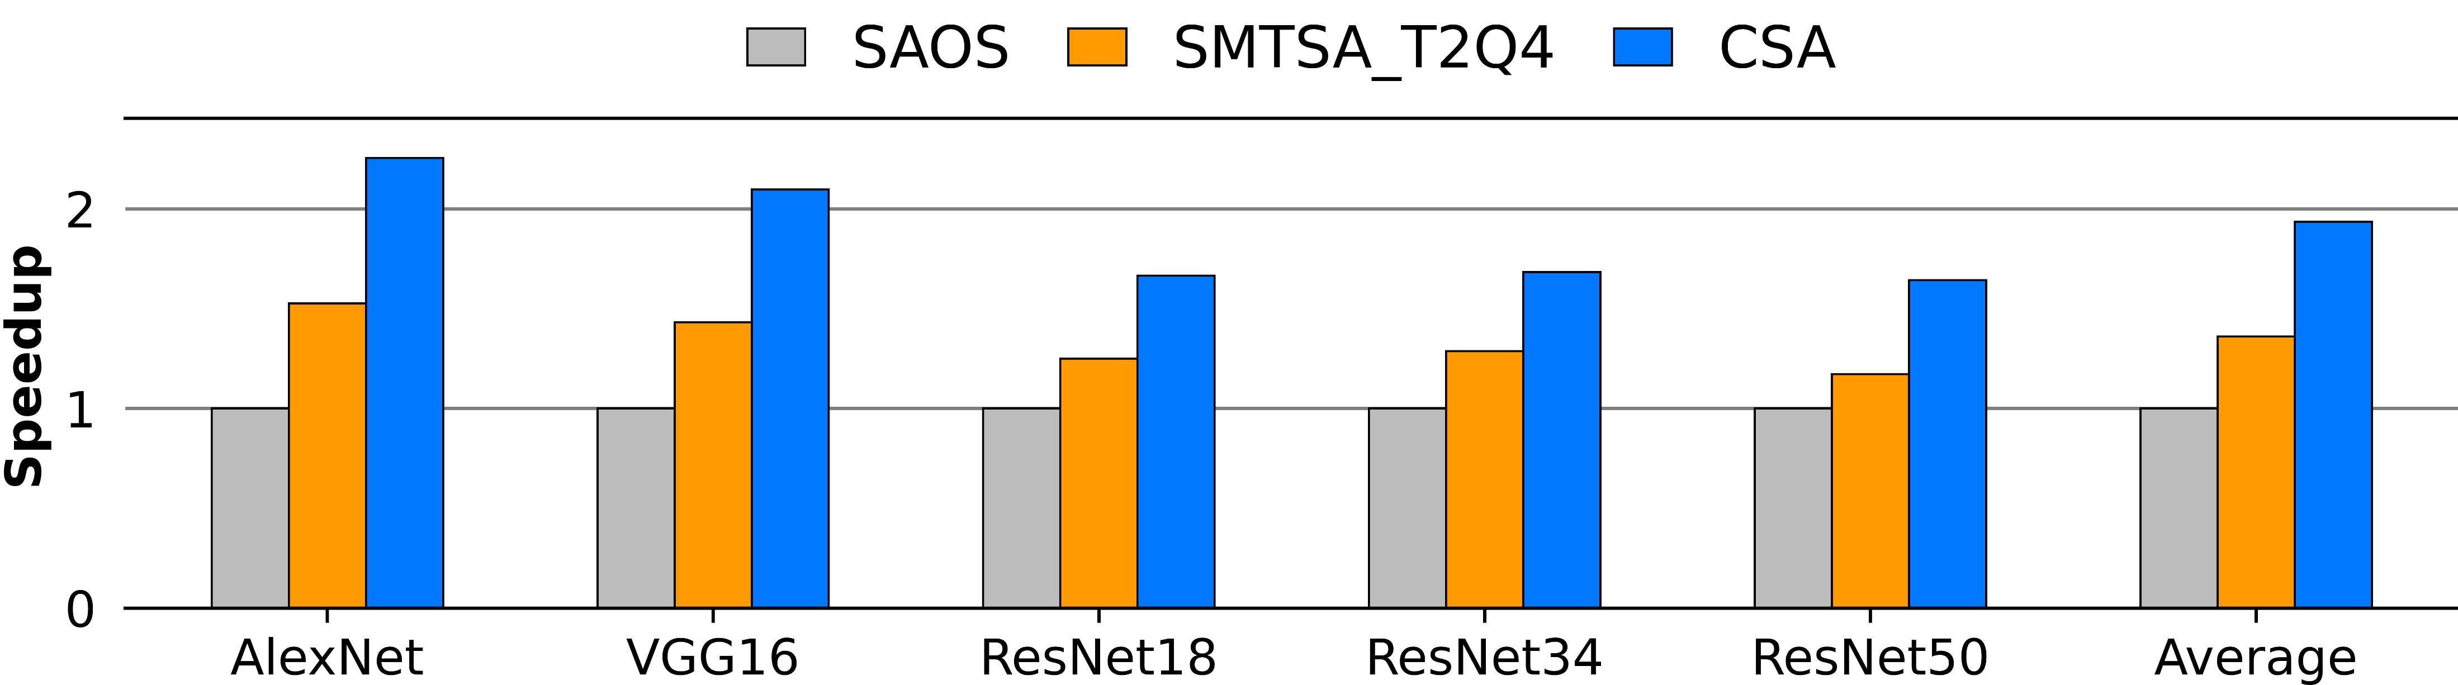
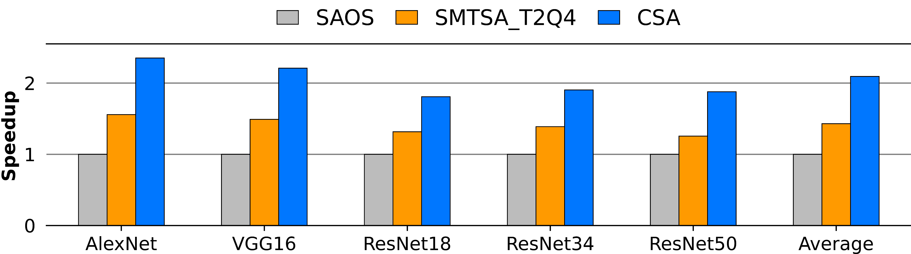
Performance Evaluation
Inference speedup of CNN models without weight pruning
  About 1.94x better performance than SAOS
  About 1.42x better performance than SMT-SA
Inference speedup of CNN models with 50% unstructured weight pruning
  About 2.09x better performance than SAOS
  About 1.46x better performance than SMT-SA
Without weight pruning
With 50% unstructured weight pruning

Slide 20
Hardware Overhead
Hardware Configuration
 | SMT-SA | Conveyor-SA
Total Number of SPU | 1024 (32x32) | 64 (8x8)
PEs per SPU | 1 (1x1) | 16 (4x4)
Total Number of PEs | 1024
Chunk Size | 8
Window Size | 4
Buffer Configuration | 2MB (Activation Buffer), 0.5MB (Weight Buffer)
Analysis on Area and Power Consumption
 | SMT-SA |  | Conveyor-SA
 | Area | Power | Area | Power
Activation Buffer | 54.59% | 58.40% | 67.87% | 76.34%
Weight Buffer | 14.76% | 14.16% | 18.35% | 18.51%
Operand Queue / Conveyor Queue | 22.86% | 24.00% | 4.49% | 1.60%
PE | 7.79% | 3.44% | 9.29% | 3.55%
Total | 4.20 mm² | 1060.27 mW | 3.38 mm² | 811.11 mW

Slide 21
Conclusion

Slide 22
Conclusion
DL workloads have high sparsity
It is important to skip ineffectual computations
The load imbalance between PEs causes PE underutilization of Sparse-SA architectures
Conveyor-SA Architecture
  Conveyor Queue to provide asynchronous dataflow to the PE array
Evaluation
  About 2x better performance than conventional systolic array
  About 1.4x better performance than systolic array with operand queues
  Conveyor Queue shows lower hardware overhead than Operand Queue

Slide 23
Thank You !

Slide 24
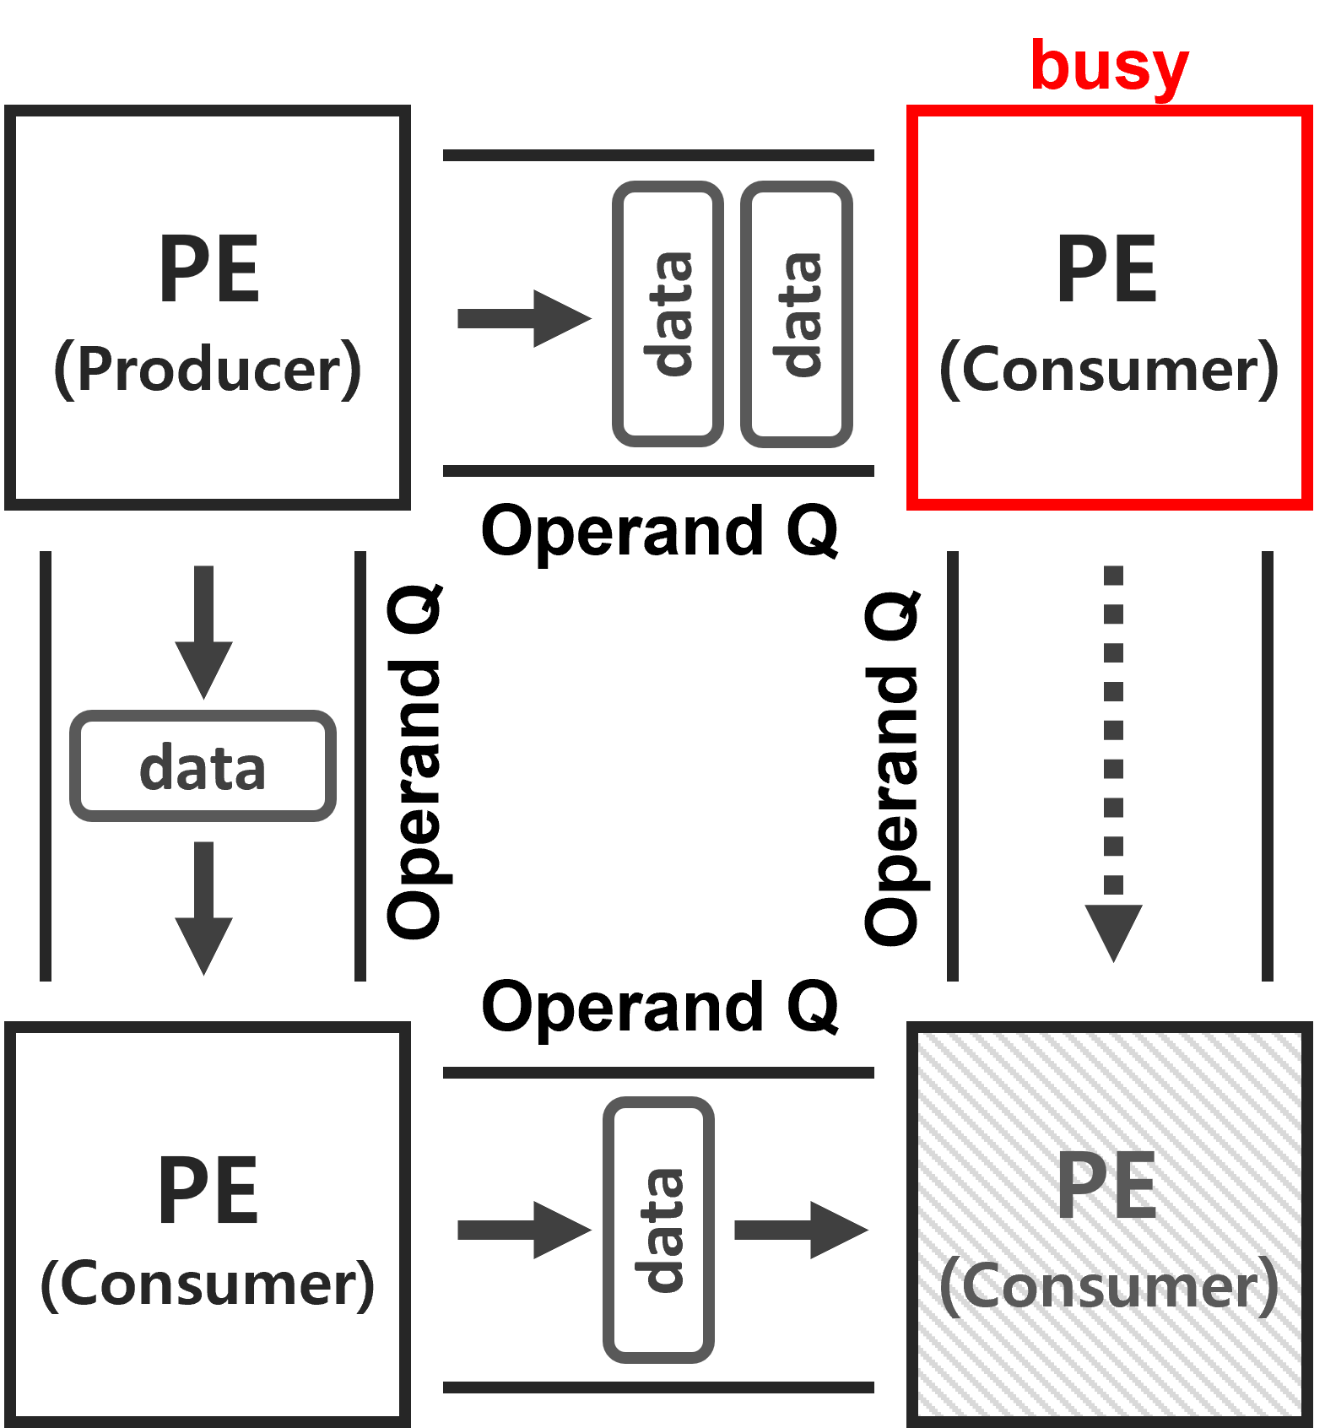
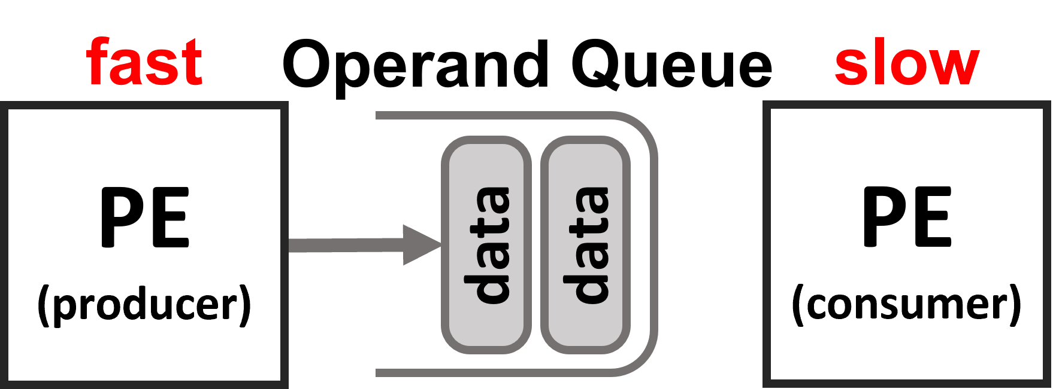
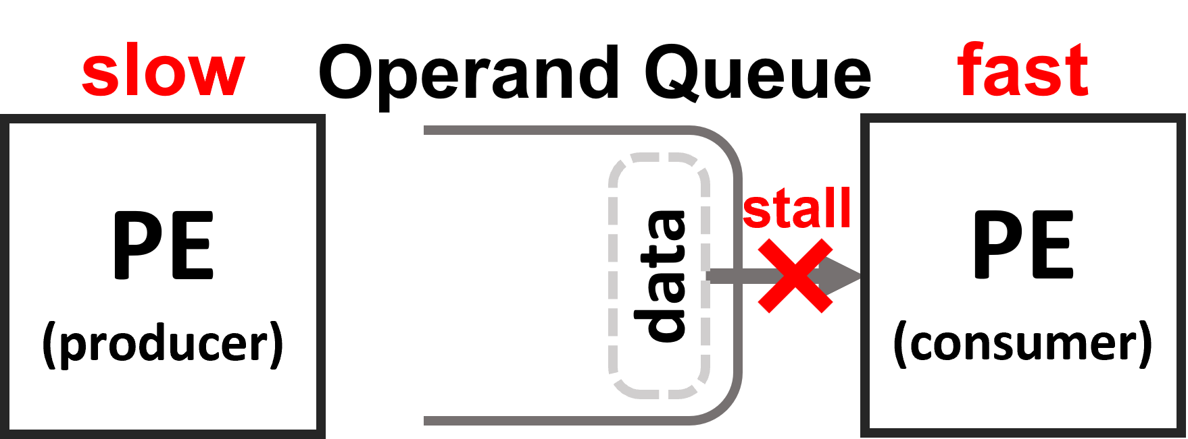
Operand Queue
What is Operand Queue?
  Insert queue based buffer between the adjacent PEs
  Fast PE transfers and receives data to and from the queue
  Only effective for fast-slow relationship scenario
Scenario 1: fast-slow relationship
Scenario 2: slow-fast relationship

Slide 25
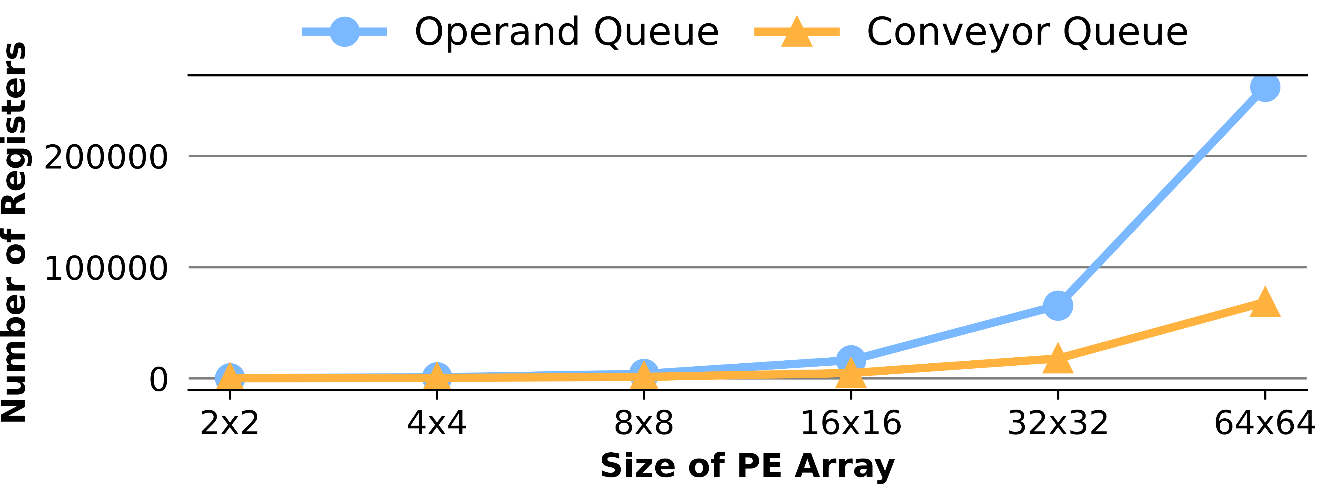
Limitation of Operand Queues
Large Hardware Overhead of Operand Queues
  Estimate the number of registers that the Operand Queue takes with respect to the size of PE array
  Operand Queue requires large number of registers
  Operand Queues take large chip area and power consumption

Slide 26
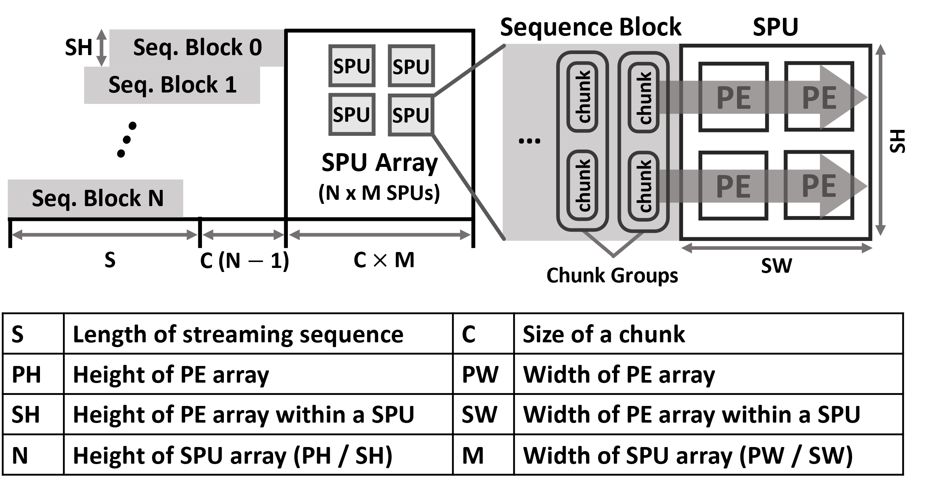
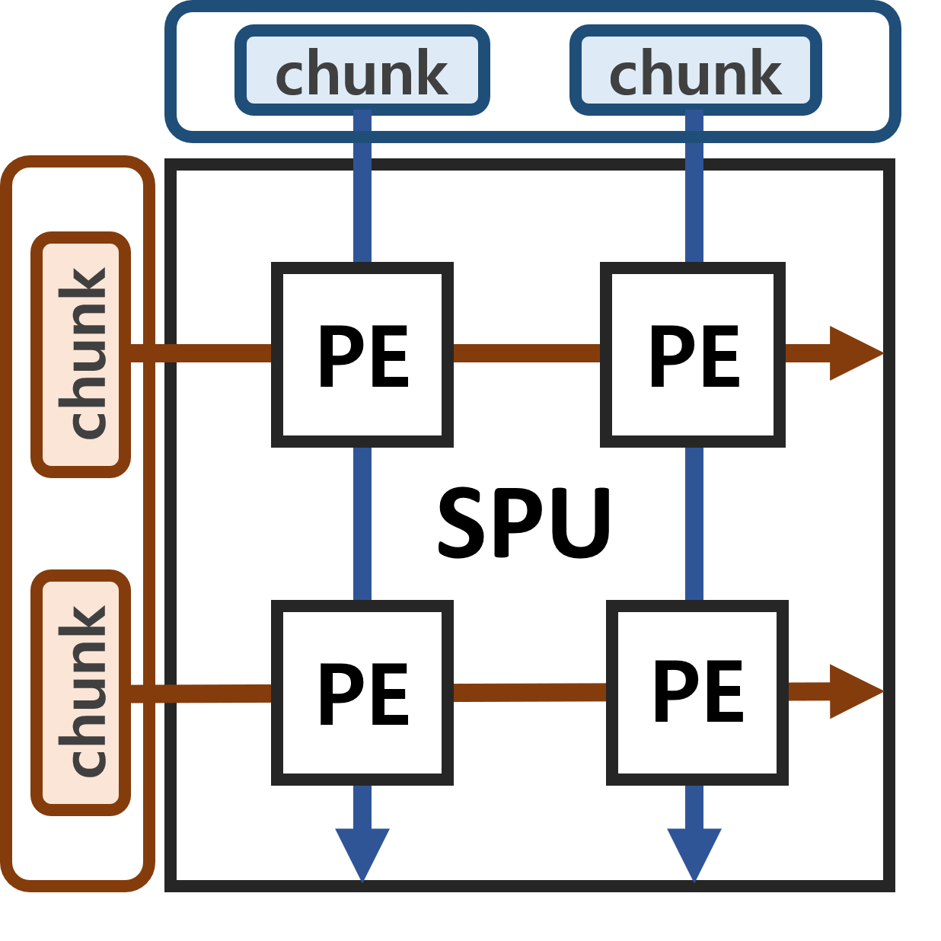
Synchronous Processing Unit
DL workloads have wide range of sparsity
It takes time to propagate dense data chunks through the Conveyor Queue
Need to improve performance for the dense workloads by reducing the propagation delay
Synchronous Processing Unit (SPU): cluster of PE sharing the same data chunk
Decrease the propagation delay of the dense data chunks by factor of the SPU dimension
Weight
Chunk Group
Activation
Chunk Group

Slide 27
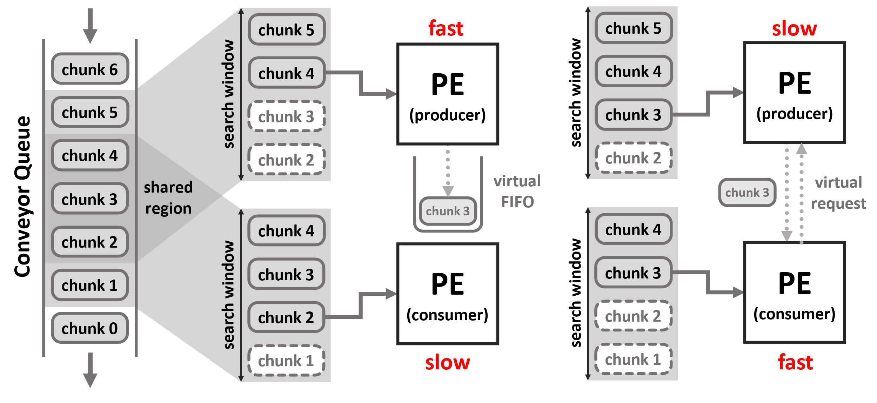
Asynchronous Dataflow with Conveyor Queue
Each PE independently fetches data chunk from its own search window
Search window of adjacent PEs are overlapping with each other
Conveyor Queue alleviates PE underutilization caused by the load imbalance issue
  fast-slow relationship: shared region provides virtual FIFO between PEs
  slow-fast relationship: shared region provides virtual handshake between PEs

Slide 28
Conveyor-SA Architecture
Read pointer (red arrow) is directed towards the data chunk currently being used
SPU fetches data chunk independently from the Conveyor Queue using read pointer
  If the read pointer points to the end of the search window, Conveyor Queue doesn’t shift the data chunks
  If not, Conveyor Queue shifts the data chunks and send response signal to the SPUs
  SPU increases read pointer to make sure that the read pointer is directed to the same data chunk
Weight Conveyor Queue
chunk group 8
chunk group 7
chunk group 6
chunk group 5
chunk group 4
chunk group 3
chunk group 2
chunk group 1
chunk group 0
SPU0
SPU1
SPU2
SPU3
shift trigger
shift response
request
response
request
response
request
response
request
response
Conveyor Controller

