Slide 1


Distributed Page Table: Harnessing Physical Memory
as An Unbounded Hashed Page Table
57th IEEE/ACM International Symposium on Microarchitecture®
Osang Kwon†, Yongho Lee†, Junhyeok Park,
Sungbin Jang, Byungchul Tak*, and Seokin Hong
Sungkyunkwan University *Kyungpook National University
† Both authors contributed equally to this work.
Notes:
Hello everyone, i’m Osang Kwon from Sungkyunkwan university in South Korea.
Today I introduce our research to you, The title is Distributed Page Table: Harnessing Physical Memory as An unbounded hashed page table.

Slide 2
Contents
Virtual memory background
Key challenges & Our goals
Distributed Page Table
Evaluation results
Notes:
This is the outline of today's presentation.
I introduce our research in the following order in this slide.
First , virtual memory background, Second one, is key challenges & our goals,
And Next, our proposed technique Distributed Page Table and Finally, the evaluation results.

Slide 3
Contents
Virtual memory background
Key challenges & Our goals
Distributed Page Table
Evaluation results
Notes:
First, let’s describe the background on virtual memory.

Slide 4
Virtual Memory System
Virtual address
x
Physical memory space
CPU
Notes:
독립적인 주소 공간
Virtual memory is a technology [@@@@] that provides an address space independent of physical memory.
However [@@@@], it is impossible to use the virtual address to directly access physical memory space.

Slide 5
Address Translation
Virtual address
Physical address
Page
Table
MMU³
CPU
Physical memory space
TLB¹
PWC²
[1] TLB: Translation Lookaside Buffer
[2] PWC: Page Walk Cache
[3] MMU: Memory Management Unit
Notes:
가상 메모리 물리 메모리 주소 변환 순서
The translating a virtual address to a physical address is a key element of virtual memory systems.
First, [@@@@] the CPU looks up the cached address translation in the TLB and the PWC within the MMU.
If there is no cached data in MMU, [@@@@] the system should access page table.
Finally, [@@@@] it is possible to access physical memory space to use physical address from page table.

Slide 6
Multi-Level Page Table (Radix Page Table)
Virtual Page Number (VPN)
9 bits
9 bits
9 bits
9 bits
  Page table walk overhead due to frequent memory accesses
  across multiple levels.
CR3
(Base address)
Physical Frame Number
Notes:
And next, conventional page table is not a linear structure but multi-level structure.
Let me explained the sequence of lookup page table.
First, [@@@@] the CR3 register holds the base address of the root page table.
The 9 bits [@@@@] of the virtual address, serve as the index for a each level page table.
After that, [@@@@] that entry can be used to access the next-level page table.
Finally, [@@@@] the physical frame number can be obtained from the last level PTE and we can use it.
This process called as page table walk. and should be accessed sequentially
So, [@@@@] the conventional system, has a page table walk overhead due to sequential memory access.

Slide 7
Hashed Page Table – Prior Works
Conventional HPT¹
PTE Clustering²
VA
VPN
Offset
VA
VPN tag
PTE Offset
Offset
HPT
HPT
Tag
PTE
PTEs
H
n
H
Number of index
Number of index
Tag
PTE
PTEs
+
1
+
+
Base
Base
[1] Architectural Support for Translation Table Management in Large Address Space Machines [ISCA 1993]
[2] Hash, don’t cache (the page table) [ACM SIGMETRICS Performance Evaluation Review 2016]
Notes:
For reducing page table walk overhead, There is a hash-based page table.
[@@@@ ]The key point of a HPT is that indexing the page table using a hash function.
[@@@@] The VPN is used as the input to the hash function, [@@@@] and its output serves as the index.
-------------------------------------------------------------------------------------------------------------------------
Additionally, [@@@@] to increase the locality of PTEs and reduce hash tag overhead, there is a method of grouping adjacent PTEs into a single cache line.
[@@@@] This is known as PTE clustering,
It is similar with before one, but the key distinction is that hashing is done excluding the PTE offset.

Slide 8
Hashed Page Table – State-of-the-Arts
Elastic Cuckoo Page Table¹
Memory Efficient
Hash Page Table²
VA
VPN tag
PTE Offset
Offset
VA
VPN tag
PTE Offset
Offset
3-way HPT
3-way HPT
H
# % CS
HPT
HPT
3
3
HPT
+
HPT
2
2
# / CS
HPT Chunk
HPT
HPT
H
1
1
1
1
PTEs
Number of index
+
c1
c2
HPT Chunk
Chunk Size (CS)
1
2
L2P Base
c3
+
+
PTEs
1
HPT Chunk
1
3
Base
1
[1] Elastic Cuckoo Page Tables: Rethinking Virtual Memory Translation for Parallelism [ASPLOS 2020]
[2] Memory-Efficient Hashed Page Tables [HPCA 2023]
Notes:
Next one is the state of the art HPT known as ECPT.
[@@@@] The main feature of ECPT is that it is a multi-way page table.
[@@@@] The access mechanism is the same as before, but it is possible to access in parallel for different way.
=============================================================================================================
[@@@@] And Next, ME-HPT is the extension of ECPT.
[@@@@] This is similar with ECPT but has distinct characteristics.
[@@@@] They addresses contiguous memory allocation by managing each page table with small chunks.
To indexing these chunks, [@@@@] ME-HPT employs the L2P table.
[@@@@] The L2P table serves as an intermediary bridge to the chunks.
[@@@@] After hashing to the L2P, [@@@@] it combines with the PTE offset to read the PTE.

Slide 9
Contents
Virtual memory background
Key challenges & Our goals
Distributed Page Table
Evaluation results
Notes:
Next, i will introduce the key challenges of current HPTs and the goals for our research

Slide 10
Key Challenges in Hashed Page Table
Fixed-size HPT
  HPT has a fixed initial size, limiting its scalability.
  Dynamic resizing
Hash collision
  Hash collisions are common, leading to potential allocation issues.
  Using techniques like Open Addressing and Chaining, which complicate access.
Using Cuckoo hashing for collision.
  Hash collisions are handled by PTE migration.
  Key Challenge: Why do the fundamental hash collisions occur?
  → Due to limited table size.
Notes:
[@@@@] First, current HPTs start with a fixed size with base address .
and if frequent hash collisions occur, dynamic resizing should be triggered.
[@@@@] Second, hash collision is an inevitable issue.
In particular, when collisions occur, open addressing or chaining can lead to complex accesses similar to page walks.
[@@@@] Third, cuckoo hashing presents a challenge.
In ECPT, there are PTE migrations during handling hash collisions.
I will explain PTE migrations for detail in next slide.
[@@@@] In summary, we can outline several issues caused by hash collisions.
[@@@@] So, why do hash collisions occur? [@@@@] We can consider the limited page table size as a primary reason.

Slide 11
What is PTE Migration?
Cuckoo Hashing in state-of-the-arts
PTEs - 1
Table-1
Table-2
PTEs - 2
Collision
Collision
PTEs - 3
Collision
Collision
PTEs - 4
PTEs - 5
→ Frequent PTE Migrations Occur.
Notes:
Let me introduce PTE migrations.
The state-of-the-art HPT uses cuckoo hashing to resolve hash collisions.
The cuckoo hash is executed through PTE migration.
[@@@@] This figure shows the allocation of PTEs through cuckoo hashing.
The cuckoo hashing is executed by migrating the PTEs between multi-way tables.
Sometimes a single PTE allocation can cause multiple cuckoo hashing.
[@@@@] As a result, cuckoo based hashing is to allocate PTEs with frequent migrations.
I’ll explain that why PTE migrations is overhead in next slides.

Slide 12
Overhead of PTE Migration - Kernel
Kernel Perspective
User thread-1
User thread-2
User thread-3
User thread-3
User thread-4
User thread-5
Page Allocation
→ User threads requesting page allocation experience delays.
Notes:
Let's consider the overhead of PTE migrations.
The first one is the kernel perspective due to increased page allocation time.
[@@@@] In multi-thread environment, the allocating page can takes too much time because of the multiple PTE migrations.
[@@@@] In this case, some user threads can experience delays.

Slide 13
Overhead of PTE Migration - Kernel
Kernel Perspective
User thread-1
User thread-2
User thread-3
User thread-4
User thread-2
User thread-3
User thread-4
User thread-5
Lock!
Lock!
Page Allocation
Page Allocation
Lock!
Release
Page Allocation
Release
Release
→ Increasing page allocation time intensify the contention for the lock.
Notes:
To explain it in more detail,
during page allocation, the memory structure must be securely protected by a lock.
When multiple threads are simultaneously allocating pages, [@@@@] there is a contention for the lock.
If a single thread holds the lock, other threads must wait until the lock is released.
[@@@@] Therefore, increasing in page allocation time may intensify the contention.

Slide 14
Overhead of PTE Migration - Coherency
Coherency Perspective
Table-1
Incorrect
Core-1
Migration
Allocation
PTEs-B
PTEs-B
PTEs-A
Core-2
Access PTEs-A
Lookup
PWC
Re-access
PTEs-A
Table-2
Core-3
Access PTEs-A
Lookup
PWC
Re-access
PTEs-A
Core-4
Access PTEs-A
Lookup
PWC
Re-access
PTEs-A
Re-access
→Resolving these inconsistencies often requires two memory accesses.
Notes:
Next is the overhead of PTE migration for coherency of page walk cache.
In a multi-core environment, [@@@@] the core 1 migrates PTE-A to another table and allocates PTE-B.
[@@@@] The core 2 may still have the cached data prior to the migration.
[@@@@] In this case, re-access to the correct PTE is necessary.
[@@@@] Similarly, if there are shared PTEs in other cores, a re-access process is also required.
[@@@@] To resolve these inconsistencies, multiple memory accesses can be triggered.

Slide 15
Our Goal: Unbounded HPT
Relative Frequency of Hash Collisions
1.0
0.5
0.0
32KB
2GB
4GB
8GB
16GB
We experiment with the frequency of hash collisions for various HPT sizes.
At a 16GB table size, the number of hash collisions is about 2.3% of those at a 32KB.
→ We aim to develop an HPT structure capable of handling huge sizes.
Notes:
Next, Let me introduce our goal.
We are sure that the hash collisions stem from the small-sized HPTs.
[@@@@] In this figure, we measured hash collisions for various size of the HPT
We can see a significant reduction for hash collisions.
[@@@@] For instance, the 16GB HPT shows 2.3% of hash collisions compared to the 32KB HPT.
[@@@@] Our research aims to develop an HPT structure capable of handling huge sizes.

Slide 16
Contents
Virtual memory background
Key challenges & Our goals
Distributed Page Table
Evaluation results
Notes:
Now, let me introduce our proposed Distributed Page Table.

Slide 17
DPT : Distributed Page Table
PTE page allocation
Physical Memory Space
VA
VPN tag
PTE Offset
Offset
PID
Data page
H
Range of hash function
PTE page
PTE page address
PFN
PTE page
PTE access
Data page
VA
VPN tag
PTE Offset
Offset
PTE
PTE page
PTE page
PID
H
PTE address
PFN
PTE Offset
Notes:
In our system[@@@@], the range of the hash function's output-span is the entire physical memory space.
Within the physical memory space [@@@@], there are both PTE pages and data pages.
---------------------------
[@@@@] For the PTE page allocation, First [@@@@] the Process ID is concatenated with the VPN tag to generate a unique hash function input.
Hash function [@@@@] generates the PTE page address, not a index of the PTE page.
And, [@@@@] the corresponding physical frame number is allocated as a PTE page.
---------------------------
Next for the PTE access [@@@@], .[@@@@]the address generation is same with the allocation.
Then, the PTE Offset is concatenated [@@@@] to access the corresponding PTE.

Slide 18
DPT : Distributed Page Table
PTE page collision
Physical Memory Space
VA - 1
VPN tag
PTE Offset
Offset
PID
H
Collision
PTE page
PTE page
PTE page address
PFN
…
Collision
Data page
Data page
VA - 2
VPN tag
PTE Offset
Offset
OR
PID
H
PTE page address
PFN
Notes:
[@@@@]However, a collision may occur when allocating the PTE page.
[@@@@] Let’s suppose the VA-1 has been allocated to [@@@@] this PTE page.
And, the VA-2 [@@@@] attempts to allocate a PTE page.
But, the generated PFN already be allocated to an [@@@@] existing PTE page or another data page.
If the PFN is already in use [@@@@], the system cannot allocate it as a PTE page.

Slide 19
Proposed Resolving Collision
To resolve collisions, three methods are proposed: SOA, CVA, and CPD.
  SOA: Strided Open Addressing
  CVA: Collision-aware Virtual Address Allocation
  CPD: Collided Page Displacement
Notes:
To resolve the challenge of hash collisions, our DPT proposes three techniques. [@@@@]
The first is Strided Open Addressing - SOA, the second is Collision-Aware Virtual Address Allocation - CVA, and the third is Collided Page Displacement - CPD.
Each technique is orthogonal and can be applied independently.

Slide 20
SOA: Strided Open Addressing
Physical Memory Space
Stride: 1
Step: 0
VA
VPN tag
PTE Offset
Offset
Strided
searching
Allocated (4KB)
Base
Stride: 1
Step: 1
Collision
H
Stride: 1
Step: 2
Allocated (4KB)
Collision
Stride: 1
Step: 3
Free (4KB)
PTE page (4KB)
Free
PTE page address
PFN
Stride: 1
Step: 1
Stride: 1
Step: 2
Stride: 1
Step: 0
Allocation!
→ Finding free pages by following the stride and step from the PFN.
Notes:
First, Let me introduce SOA.
[@@@@] This is an extension of open addressing.
[@@@@] Initially, the process starts with a Stride of 1 and a Step of 0.
Stride of 1 means a 4KB page, [@@@@] and the Step indicates how many strides away from the base.
[@@@@] [@@@@] If the accessed with Stride 1 and Step 0 has already been allocated, it is address collision,[@@@@] and Strided Searching begins. like this
stride 1 and step 1 [@@@@] stride 1 and step 2[@@@@]
Finally, [@@@@] after searching, a free page is found at Stride 1 and Step 2, so this page can be used as the PTE page.
In summary, [@@@@] SOA increments the step and stride to find for the next free page.

Slide 21
CVA: Collision-Aware Virtual Address Allocation
Virtual Memory Space
Physical Memory Space
Free (2MB)
VPN tag
Allocated (4KB)
Collision
Search collision-
free region
H
Allocation!
Free (2MB)
Free (4KB)
PTE page (4KB)
Free
VPN tag + 1
Use virtual address of this region
→ Allocating a virtual address region where collisions do not occur.
Notes:
Next is CVA.
[@@@@] Let’s suppose that the generated PTE page address has collided with the other page.
In this case, the system searches for a virtual address space that collision-free region. [@@@@]
For example, by adding 1 to the VPN tag, [@@@@] the system can skip over 2MB of virtual address space.
If this address space is free[@@@@], the PTE page is allocated, and we can use this virtual address space
[@@@@] Thus, by modifying the virtual address, the system can allocate collision-free PTE pages.

Slide 22
CPD: Collided Page Displacement
Physical Memory Space
Allocation!
VA
VPN tag
PTE page (4KB)
Victim (4KB)
Allocated (4KB)
Migration!
Collision
Allocated (4KB)
H
Victim (4KB)
Free (4KB)
PTE page address
PFN
PTE page
for Victim
Update PTE of Victim
→ By applying SOA and CVA first, the system minimizes migrations.
Notes:
Last one is CPD.
SOA and CVA aim to avoid collisions, but sometimes there are cases where collisions cannot be avoided.
In this case, we should handling hash collisions.
If the generated PTE address has collision [@@@@] and this allocated page is movable page, it can be selected as the victim page [@@@@].
The victim page is migrated to free pages [@@@@], and [@@@@] the PTE page of the victim should be updated about this migration.
Then, the system allocates the PTE page [@@@@] to the original location.
================================================================
CPD is a technique that applies at the end.
[@@@@] By applying SOA and CVA first, we minimize page migrations to reduce performance overhead.

Slide 23
Contents
Virtual memory background
Key challenges & Our goals
Distributed Page Table
Evaluation results
Notes:
Now, we will show the performance, address translation characterization and sensitivity analysis of the DPT system.

Slide 24
Evaluation Methodology
Sniper multicore simulator
  Virtuoso¹
    Open-source for Virtual memory research
  Extended with
    Page table walker, Migration overhead
    Page fault handling, Memory utilization
Comparative analysis
  RPT: Baseline with radix page table
  ME-HPT²: State-of-the-art hashed page table
  MOSAIC³: State-of-the-art large TLB coverage mechanism
Component | Configuration
CPU | 4core, OoO, 2.66GHz
L1 TLB | 4KB : 64-entry 2MB : 32-entry
L2 TLB | 1536-entry, 12-way
Memory | 16GB, DDR4-3200
Page Walk Cache | 3-level split PWC, 16/16/32-entry, 4-way
[1] https://github.com/CMU-SAFARI/Virtuoso
[2] Memory-Efficient Hashed Page Tables [HPCA 2023]
[3] Mosaic Pages: Big TLB Reach with Small Pages [ASPLOS 2023]
Notes:
Here is the evaluation methodology.
We used the Sniper multi-core simulator with Virtuoso extension.
This simulator is extended to support page table walkers, migration overhead analysis, page fault handling, and memory utilization.
We configured the Sniper to have 4 core with out-of-order execution, along with L1 and L2 TLB, main memory, page walk cache.
We compare the performance and address translation of the DPT system to those of RPT, ME-HPT, and MOSAIC.
RPT is the baseline of the conventional system. And the other technique is the state of the art for HPT and large TLB coverage.

Slide 25
Performance Results
RPT
MOSAIC
ME-HPT
DPT
1.2
1.33
8.7%
1.1
1.0
Speedup
0.9
0.8
BC
BFS
CC
DLRM
GEN
GC
PR
RND
SSSP
TC
XS
GMEAN
  DPT achieved performance improvement of 12.6%, 11.6%, and 8.7% compared to RPT, MOSAIC, and ME-HPT, respectively.
Notes:
As shown in this figure, DPT system achieves an [@@@@] average speedup of [@@@@] about 12% over the RPT, 11% over the MOSAIC, and 8% over the ME-HPT system.

Slide 26
Breakdown of Translation Requests
DRAM
LLC
L2C
L1C
1.5
69.3%
Ratio
1.0
0.5
0.0
RPT
ME-HPT
DPT
RPT
ME-HPT
DPT
RPT
ME-HPT
DPT
RPT
ME-HPT
DPT
RPT
ME-HPT
DPT
RPT
ME-HPT
DPT
RPT
ME-HPT
DPT
RPT
ME-HPT
DPT
RPT
ME-HPT
DPT
RPT
ME-HPT
DPT
RPT
ME-HPT
DPT
RPT
ME-HPT
DPT
BC
BFS
CC
DLRM
GEN
GC
PR
RND
SSSP
TC
XS
GMEAN
  DPT reduced memory requests by 43.5% compared to RPT and by 69.3% compared to ME-HPT by eliminating sequential access in RPT and parallel multi-way lookups in ME-HPT.
Notes:
Next, let me show the breakdown of translation requests of the DPT.
[@@@@] On average, DPT reduces translation memory requests by 43% compared to RPT and by 69% compared to ME-HPT.
[@@@@] This reduction is achieved by elimination the multi-level page walk in RPT and the parallel multi-ways access used in ME-HPT.

Slide 27
More in the Paper
Fragmentation-Aware PTE allocation
  Selecting pages which already broken into non-contiguous 4KB pages.
DPT parameter (Stride, Step) management
  DPT specific data structure and MMU cache.
DPT Implementation in Linux Kernel
How to support virtualization
More experimental results
Notes:
This is the end of my presentation.
In our paper, you can also find additional details on the following topics.
First, how to address the memory fragmentation caused by hashing to entire memory.
And Next, how to store and manage about step and stride value.
Third, our paper also covers the Linux kernel to support DPT, as well as how to support DPT in a virtualized environment.
If you're interested, I encourage you to look at our paper for more information.

Slide 28
Conclusion
Address translation causes performance bottlenecks in modern systems.
  The conventional Radix Page Table (RPT) has limitations.
  A hash-based Hashed Page Table (HPT) is being proposed.
  But, due to overhead, the performance improvement is limited.
Distributed Page Table (DPT) system -> Eliminates overhead.
  Strided Open Addressing (SOA)
  Collision-aware Virtual Address Allocation (CVA)
  Collided Page Displacement (CPD)
12.6% Performance gain over the RPT (8.7% over the state-of-the-art HPT)
Notes:
[@@@@] In summary, DPT is a technology designed to mitigate the bottleneck in address translation found in conventional systems.
[@@@@] DPT is a technique that utilizes a hash function over the entire memory space, allowing the entire physical memory to be used as a large HPT.
It can effectively reduce hash collisions, and it also introduces techniques to resolve certain hash collisions : SOA, CVA, CPD.
[@@@@] In conclusion, we demonstrate performance improvements compared to both conventional systems and state-of-the-art methods.

Slide 29
Thank you
Notes:
Thank you for listening to the presentation, and please feel free to ask any questions if you have them.

Slide 30
Backup slide

Slide 31
Performance with Memory Utilization
70%
80%
90%
94%
98%
1.4
3.3%
1.2
Speedup
1.0
0.8
BC
BFS
CC
DLRM
GEN
GC
PR
RND
SSSP
TC
XS
GMEAN
  The performance improvement of DPT over RPT remains stable up to 80% memory utilization, with a slight decline of about 3.3% at 98% utilization.
Notes:
For fully utilized memory, it is not different with the conventional swap mechanism.
Additionally, We evaluate for various memory utilization.
For high memory utilization such as 98%, there is a little performance degradation about 3.3%.
Page table is much smaller than the other page. so it is possible to be executed clearly with high memory utilization.
As far as I know, in linux system, the default value for swappiness is 60. Therefore, in most cases, we expect that DPT can operate normally.

Slide 32
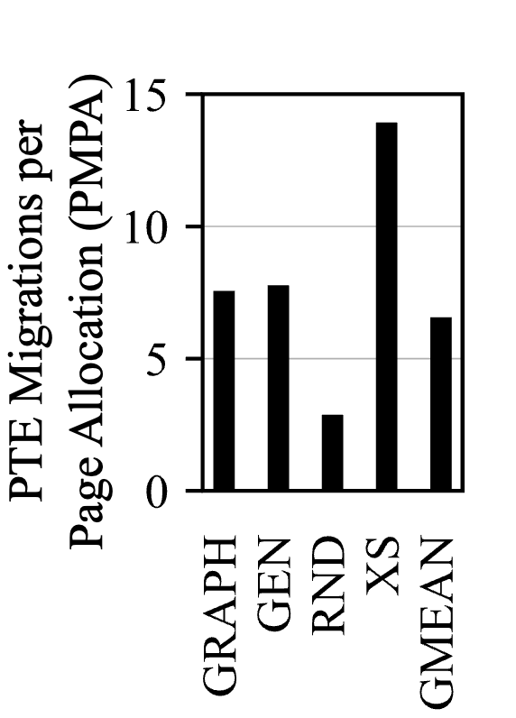
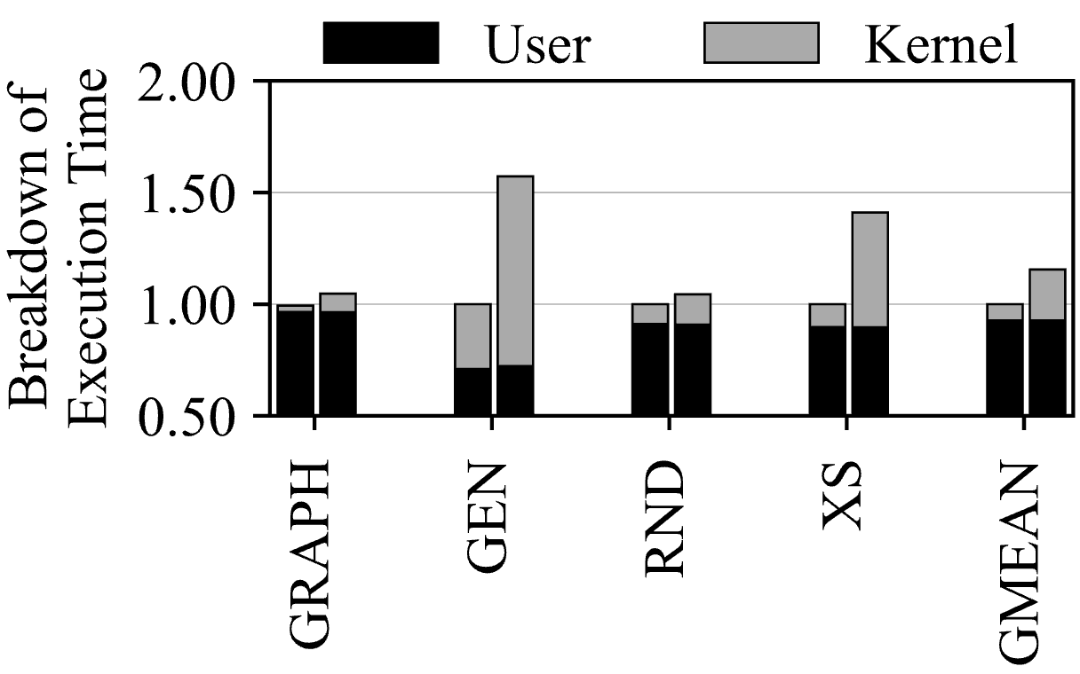
Overhead of PTE Migration - Experiment
Frequency of PTE migrations (left) and their performance impact (right) in a conventional system.
Notes:
We modifiy linux kernel code to measure PTE migration overhead.
In page allocation code, we added PTE migration code and compare execution time for various workloads.
In our evalution, for PTE migration case, there is about 15% of performance reduction.

Slide 33
Fragmentation-aware PTE Allocation
Physical Memory
Space
Physical Memory
Space
Non-fragmented!
VA
VPN tag
VA
VPN tag
Free
(2MB)
Free
(2MB)
H
H
Free (4KB)
Fragmented!
2MB
PTE page address
PFN
PTE page address
PFN
Allocated (4KB)
Free (4KB)
Allocated (4KB)
PTE page Allocation!
Notes:
In our paper, there is a detail information for Fragmentation issue. Let's briefly explain.
DPT choose first already fragmented pages for PTE page allocation.
For example, [@@@@]hash function output is A, and [@@@@] A page is segment of large page and a free status. So, we do not use this page.
[@@@@] If the hash function output is B, [@@@@] and B page is already fragmented region than use it.
DPT use fragmented page first.
Additionally, in linux system, it it possible to detect that this page is fragmented or non-fragmented by compound_order() that kernel function. This function return order of buddy alloctor.

Slide 34
Multiple Page Size
How to support huge page?
4KB Page
VA
VPN tag
PTE Offset
Offset
PID
H
PTE address
PFN
PTE Offset
H
PID
2MB Page
VA
VPN tag
PTE Offset
Offset
9-bit (512-4KB page)
Notes:
In previous slide, I didn't mention page size separately, and I assumed the default page size.
But there's nothing special about huge page.
First of all, the top is based on the 4KB page, and the bottom one is 2MB huge page.
The difference between the two is simple. You can increase the offset bit and exclude some bits from the VPN tag as hash input.

Slide 35
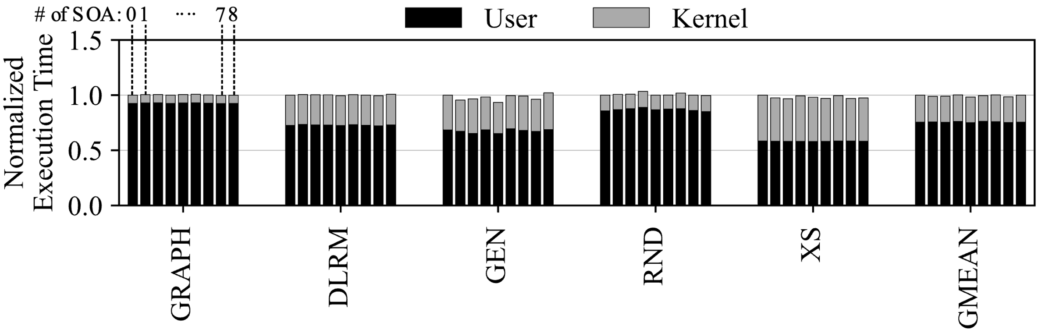
Effectiveness of DPT Components
Performance overhead of the strided search of SOA in Linux system.
Notes:
DPT’s SOA effectively avoids address collisions but requires repeated checks of the page status to find a free physical frame.
This figure shows the overhead of SOA in a real system.
As shown in the figure, the performance impact of repetitive search of the SOA is very small.
This is because this process involves accessing a small structure that is typically cached.

Slide 36
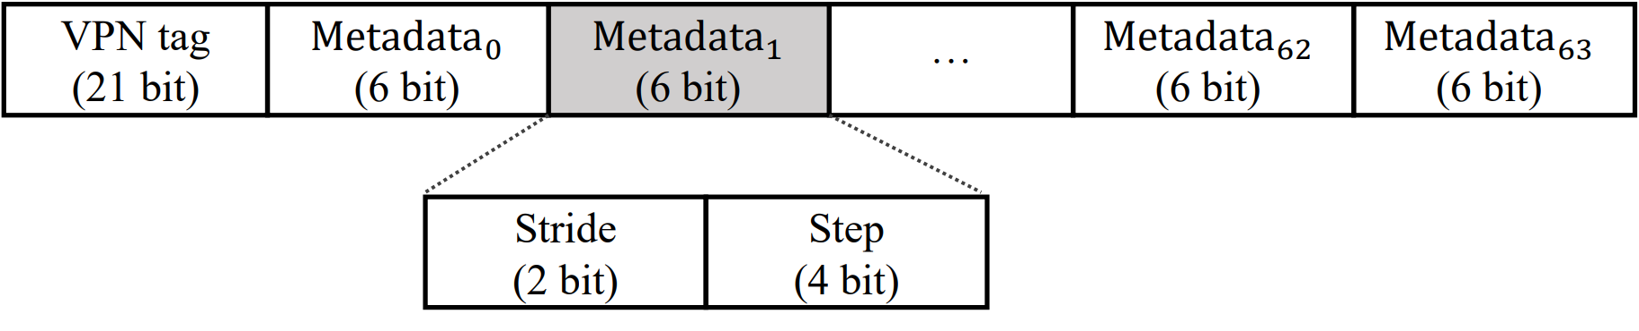
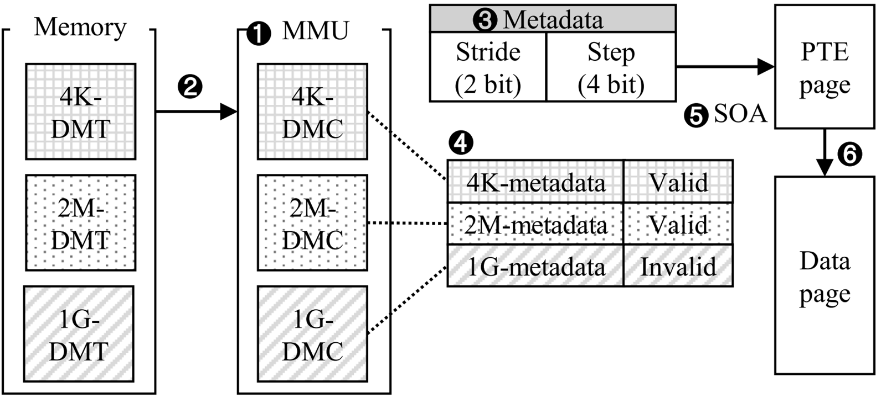
DPT Parameter Management
DPT metadata table for Stride and Step.
Repurposing MMU cache for DPT metadata.
Notes:
In DPT, MMU cache is repurposed for DPT metadata such as step and stride. If there is a cached data in MMU , we can directly access PTE pages except for accessing metadata table.
-------------------------------------------------------------------------------------------------------------------------------------------------------------------------------------------------------------
For supporting multi-page size we also separate MMU cache per page size.
How to access MMU cache is written on the paper for several senario, so it would be good for you to refer to it.

Slide 37
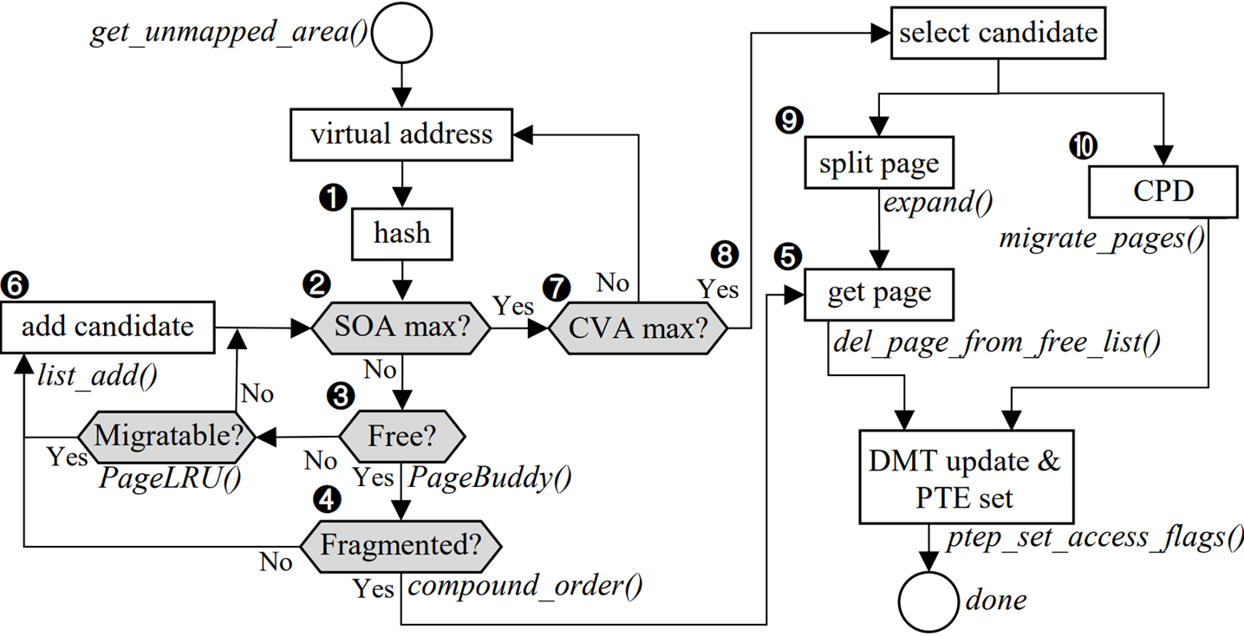
How to Implement DPT in Linux Kernel
PTE page allocation flow in Linux kernel with DPT.
Notes:
In our paper, there is a PTE page flow for linux kernel. It's a complicated part, so it would be good to refer to paper for more detail.
Let’s briefly explain, We do not implement full DPT system in Linux. But We consider that how to implement.
We think about that it is possible to adapt DPT with conventional system.
In linux kernel, there are various Macro function for page descriptor or page management.
These functions is usefull for a DPT system for a checking the free or allocation status, fragmentation information and so on.
We are still considering how to implement and it is future work for me.

