Slide 1



Performance Characterization of CXL Memory
Expander: Impact on Read and Write Latencies
ICCE-ASIA ‘24: International Conference on Consumer Electronics
Junbum Park, Wonyoung Lee, Taejeong Kim, Yongho Lee, and Seokin Hong
Sungkyunkwan University, Samsung Electronics
Notes:
Good afternoon, everyone.
My name is JunBum Park, and I am currently pursuing my graduate studies while working at Samsung Electronics.
Today, I am here to present our research paper titled Performance Characterization of CXL Memory Expander: Impact on Read and Write Latencies.

Slide 2




Introduction
There is a bottleneck between the CPU and memory (DRAM).
DRAM (DDR4 DIMM)
BOTTLENECK
1
Notes:
1. Increasing Memory Demand
"Currently, the rapid growth of applications like machine learning, artificial intelligence, and large-scale databases is driving a significant increase in memory demand."
2. Limitations of Traditional DIMM Interfaces
"These applications require high memory capacity and bandwidth. However, traditional DIMM interfaces are reaching their limits due to physical constraints within the CPU package."
3. Impact on Performance
"With a limited number of DIMM slots and restricted memory bandwidth, CPU performance is being constrained, creating bottlenecks, especially in data-intensive applications."
4. Major Challenge for Computing Systems
"This issue is a key challenge in today’s computing systems and highlights the urgent need for new approaches to memory expansion."
5. Introduction of CXL Technology
"Given this background, we introduce CXL technology as a potential solution, which will be discussed in more detail in the next slide."

Slide 3


CXL Technology Overview
CXL (Compute Express Link) opens up the possibility to connect an unlimited number of memory modules (DRAM).
Memory
Memory
…
Memory
CXL
over PCIe Interface
2
Notes:
1. Introduction to CXL
"CXL, or Compute Express Link, is a high-speed interconnect technology that provides flexible and scalable connections between CPUs, memory, and accelerators like GPUs."
2. Key Advantage: Memory Expansion
"One of the major benefits of CXL is its ability to enable virtually unlimited memory expansion."
"Traditional DIMM interfaces are limited by the physical constraints of the CPU package, but CXL overcomes this by using the PCIe interface."
3. Enhanced Scalability
"Through PCIe, CXL supports multiple memory modules, which greatly improves scalability."
4. Shared Memory Pool for CPUs and GPUs
"Another advantage of CXL is that it allows both CPUs and GPUs to access a shared memory pool."
"This shared access means data can be transferred more efficiently between different computing resources."
5. Performance Benefits
"With minimized data movement, CXL helps improve overall system performance, making it especially beneficial for data-intensive workloads."
6. Summary
"In summary, CXL expands connectivity options among CPUs, memory, and accelerators, making it ideal for complex computational environments."

Slide 4
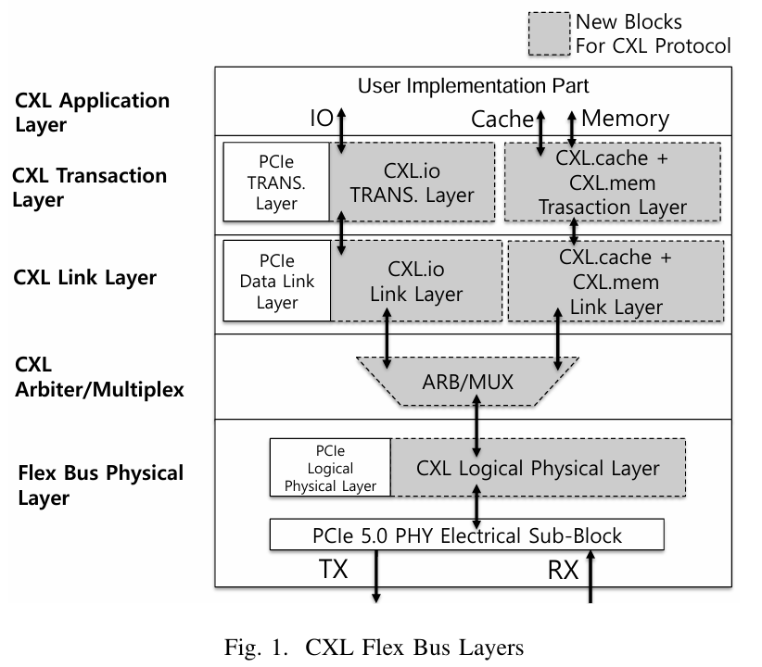
CXL Protocol (Flex Bus Layer)
CXL.mem provides byte-level memory access, while CXL.cache allows the device to cache the host's memory region.
3
Notes:
1. Overview of the CXL Protocol
"The CXL protocol, as shown in Figure 1, is structured into multiple layers. It inherits key elements from traditional PCIe but also introduces additional features to meet the needs of modern computing."
2. Three Main Components
"The protocol is organized around three main components: CXL.io, CXL.cache, and CXL.mem."
"Starting with CXL.io, this layer maintains compatibility with existing PCIe functionality, handling essential tasks such as device discovery and error reporting."
3. Advanced Capabilities with CXL.cache and CXL.mem
"Moving on to CXL.cache and CXL.mem, these layers introduce more advanced capabilities."
"CXL.mem allows byte-level memory access, which provides fine-grained control over memory operations."
"Meanwhile, CXL.cache enables devices to cache the host side memory region, improving data access speed and overall efficiency."
4. Data Transfer Mechanics
"Packets enter the protocol through the RX, or receive side, and exit via the TX, or transmit side, allowing for bidirectional data transfer."
5. User Implementation Area
"Within the user implementation area, we have a DRAM controller and DRAM located on the device, which handle memory interactions. This part will be explained in more detail on the next slide."
6. ARB/MUX Role
"The ARB/MUX component plays a crucial role by determining whether packets should be routed through CXL.io or processed by CXL.cache and CXL.mem, ensuring efficient data handling."
7. Summary of Benefits
"By integrating these layers and features, the CXL protocol creates a unified, high-performance interconnect that can adapt to the evolving demands of modern computing environments."

Slide 5
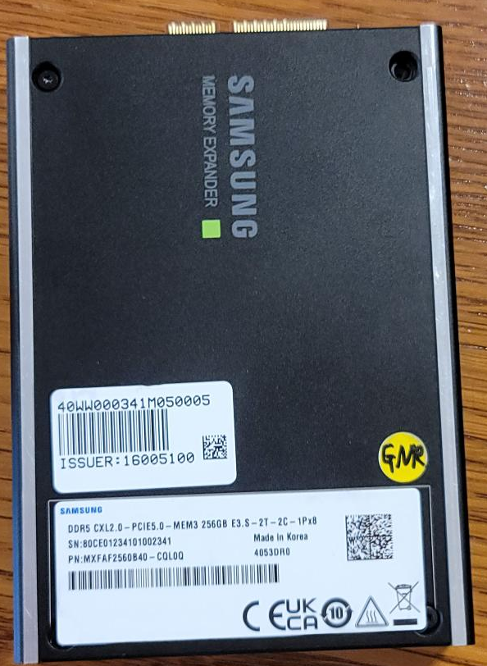
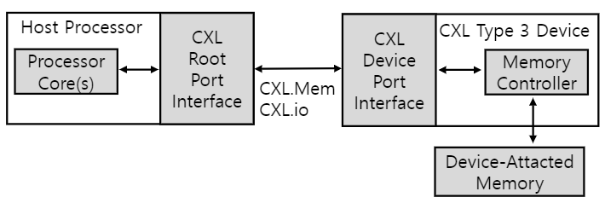

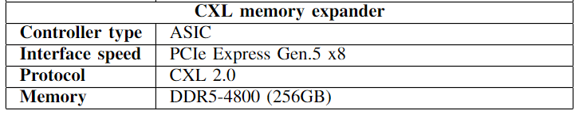
CXL Type-3 Device
A CXL type-3 device uses only CXL.mem and CXL.io,excluding CXL.cache.
  This device type primarily operates using CXL.mem to service requests sent from the host.
4
Notes:
1. Overview of CXL Type-3 Device
"A CXL Type-3 device operates using only the CXL.mem and CXL.io protocols, excluding CXL.cache."
"It mainly relies on CXL.mem to handle memory access requests from the host."
2. Connection and Latency Factors
"Unlike traditional DRAM that is directly connected to processor cores, this device connects through a CXL Root and Device Port Interface."
"This introduces an increase in latency due to additional layer traversals and the physical link length."
3. Samsung's CXL Memory Expander for Evaluation
"For our evaluation, we used Samsung's CXL memory expander, as shown in the photo."
4. Key Specifications
"This device is equipped with an ASIC controller and operates over a PCIe Gen 5 x8 interface, following the CXL 2.0 protocol."
"It includes 256GB of DDR5-4800 memory, with a data transfer rate of 4800 MT/s."
5. Summary of Benefits and Trade-offs
"Despite the latency trade-offs, this setup offers a flexible and high-capacity memory expansion solution."

Slide 6
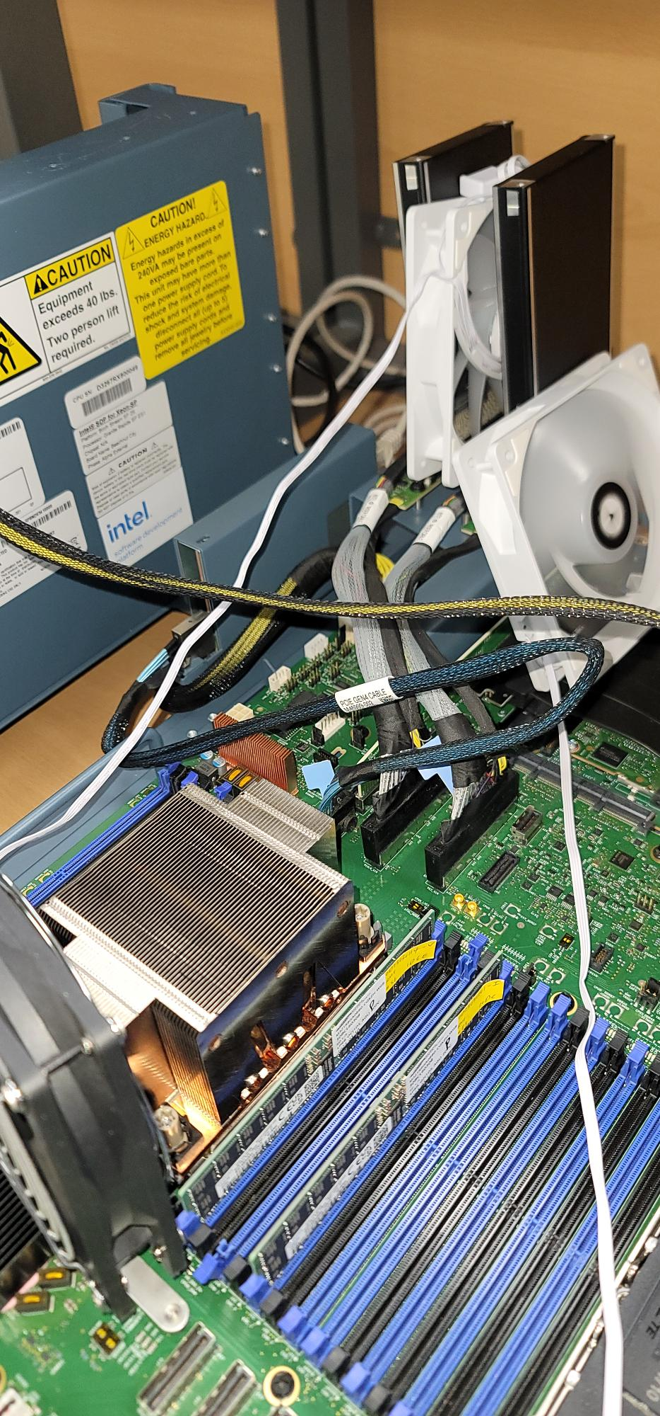
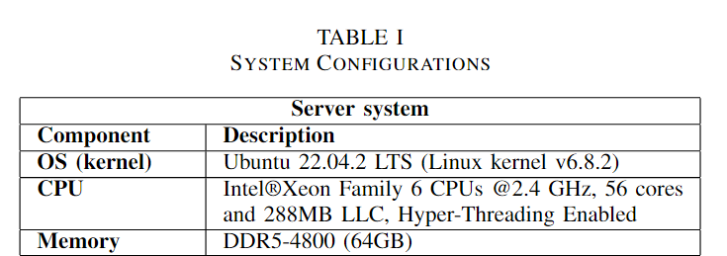
Experimental Setup
Using the latest Intel Xeon Granite Rapids server to evaluate the performance of the CXL type-3 device.
CXL Memory Expander
Programmer transparent memory management
Local Memory
CXL Memory
CXL BUS
DIMM Interface
CPU
Local DRAM
CXL BUS
CXL Memory Expander
5
Notes:
1. Introduction to the Experimental Setup
"In this experimental setup, we used the latest Intel Xeon Granite Rapids server to evaluate the performance of the CXL Type-3 device."
2. System Configuration
"The system configuration, as shown in the table, includes Ubuntu 22.04.2 LTS as the operating system."
"It runs on an Intel Xeon CPU with 56 cores at 2.4 GHz and has 64GB of DDR5-4800 local DRAM."
3. Samsung CXL Memory Expander Integration
"The setup also includes a Samsung CXL memory expander, connected via the CXL bus to provide additional memory through the CXL protocol."
4. Memory Operation and Management
"The CXL memory operates alongside the local DRAM and supports transparent memory management for programmers."
5. Purpose of the Setup
"This configuration allows us to assess how the CXL memory expander performs in a real-world server environment."
"It enables us to directly compare the performance of CXL memory with traditional memory solutions."

Slide 7
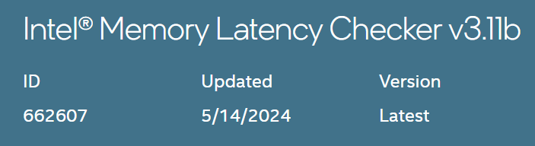
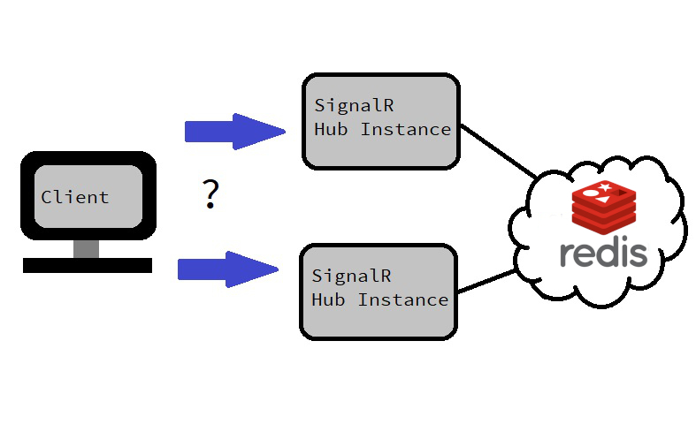
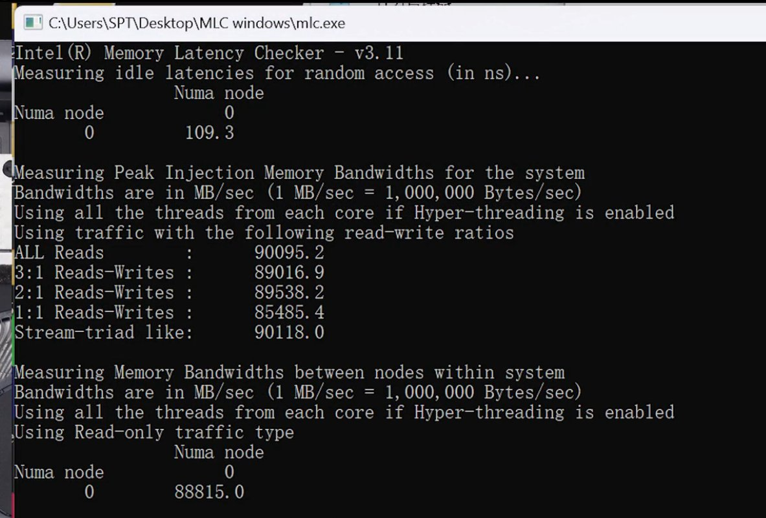
Workloads
MLC
  Intel memory Latency Checker (MLC) is a benchmark tool for measuring memory latency and bandwidthon Intel-based systems
In-memory database
  Redis is an open-source, in-memory data structure store known for its high performance and support for various data types such as strings, lists, and sets
Server
6
Notes:
1. Introduction to Workloads for Evaluation
"In this setup, we used two primary workloads to evaluate the performance of the CXL memory expander."
2. Intel’s Memory Latency Checker (MLC)
"The first tool is Intel’s Memory Latency Checker, or MLC, which is designed to measure memory latency and bandwidth for Intel-based systems."
"MLC provides detailed latency data, helping us understand the memory performance characteristics of the CXL setup."
3. Redis as an In-Memory Database
"The second workload involves an in-memory database, Redis."
"Redis is an open-source data structure store known for its high performance and flexibility in handling data types such as strings, lists, and sets."
4. Purpose of Using Redis
"By using Redis, we can assess how well the CXL memory expander performs in real-time data handling and high-demand storage scenarios."
5. Insights from Workload Testing
"These workloads offer valuable insights into the suitability of the CXL memory expander for various data-intensive applications."

Slide 8
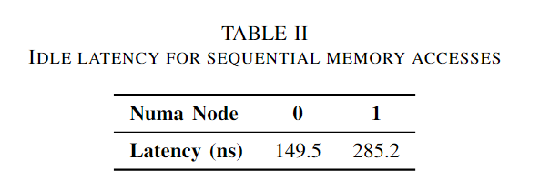
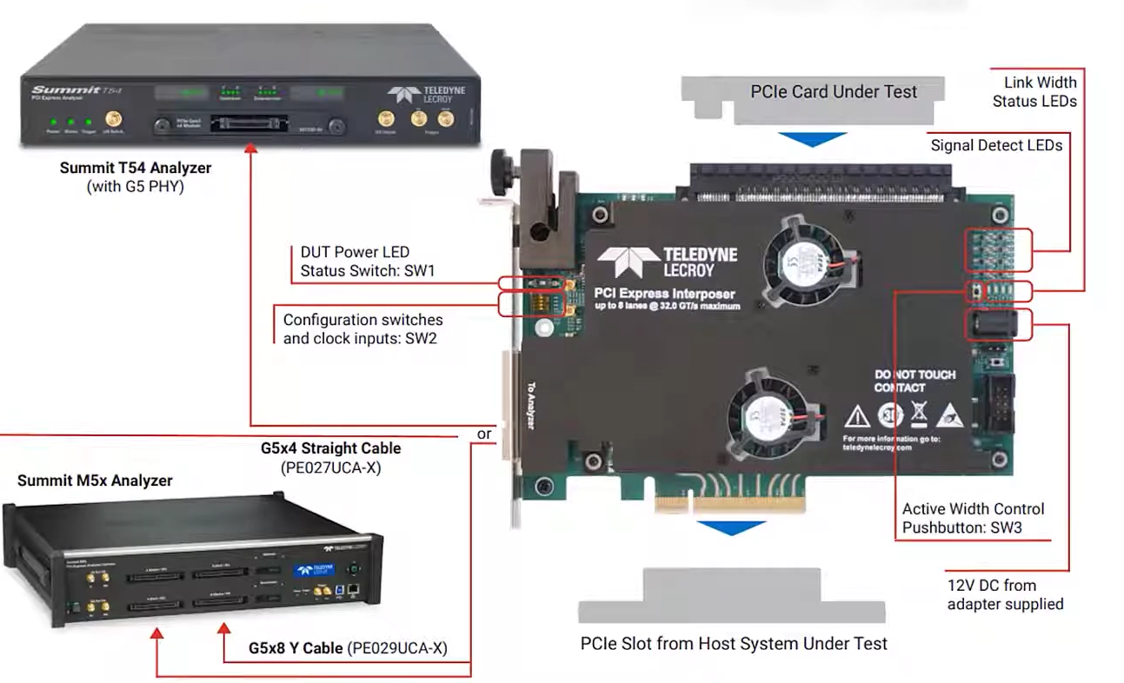
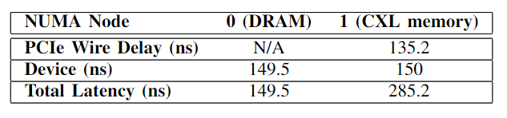
MLC Results – Idle Latency
Latency comparison
  There is a 135.7 ns difference in access time between DRAM and the CXL Mem Exp.
  CXL Memory Expander introduces ~90.77% higher latency than local memory
  The PCIe wire delay has the greatest impact on the increase in latency.
  It accounts for 52% of the total latency.
CXL Memory Expander
Protocol Analyzer
CXL Memory Expander (Node 1)
CXL BUS
(PCIe Wire delay)
CPU
Local DRAM (Node 0)
- A protocol analyzer that enables measurement of PCIe wire delay
- Real System View
7
Notes:
1. Focus of MLC Test Results
"In our MLC test results, we focused on comparing the idle latency between local DRAM and the CXL memory expander."
2. Observed Latency Difference
"We observed that the CXL memory expander has a 135.7 ns longer access time than local DRAM, resulting in approximately 90.77% higher latency."
3. Key Contributor: PCIe Wire Delay
"The main contributor to this increased latency is the PCIe wire delay, which accounts for about 52% of the total latency."
4. Role of Protocol Analyzer
"As shown in the system setup, the protocol analyzer is positioned in front of the CXL memory expander, allowing it to monitor all incoming and outgoing packets to and from the device."
5. Insights from Setup
"This setup enabled us to precisely measure the PCIe wire delay and understand how the physical link and device processing affect overall latency."
6. Summary of Trade-Offs
"These findings illustrate the performance trade-offs when using CXL memory instead of directly attached DRAM."

Slide 9





Test Setup: Real-World Workload (Redis)
Server
Ethernet
DIMM I/F
Local DRAM (Node 0)
CXL BUS
CXL Memory Expander (Node 1)
C -
Only
100
8
Notes:
1. Purpose of Redis Workload
"We used Redis as a real-world workload to evaluate the performance of the CXL memory expander under different access patterns."
2. Setup Overview
"The setup involves a client connecting to a server via Ethernet. The server is equipped with both local DRAM and a CXL memory expander."
3. Workloads with Yahoo! Cloud Serving Benchmark (YCSB)
"Using the Yahoo! Cloud Serving Benchmark, or YCSB, we tested three types of workloads."
"Workload A is update-heavy with a 50/50 read-update ratio."
"Workload B is read-heavy, with a 95/5 read-update ratio."
"Finally, Workload C is read-only, with 100% read operations."
4. Observing Performance Across Workloads
"This setup allowed us to observe the actual performance of the CXL memory expander in handling various read and update demands."
5. Real-World Comparison
"Through these tests, we could compare the CXL memory expander’s performance with traditional DRAM under data-intensive conditions."

Slide 10
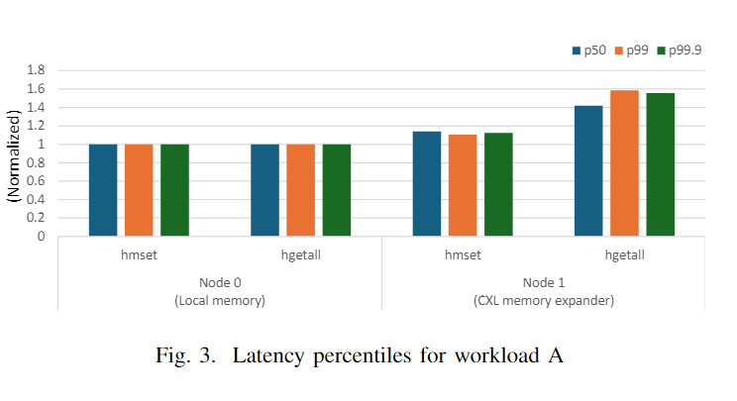
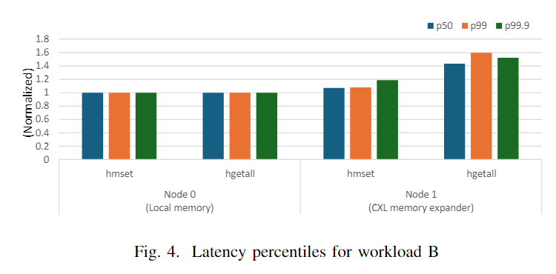
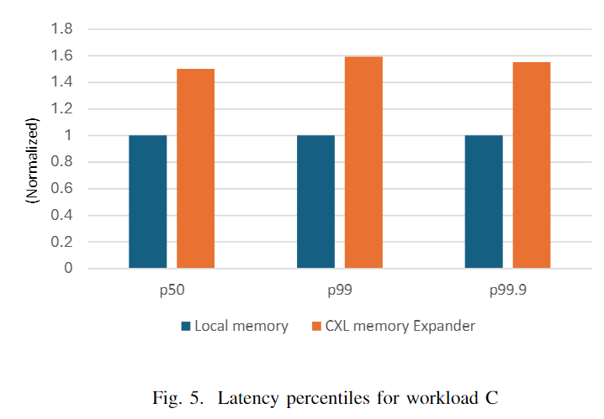
Comparative Analysis of Workloads
Latency comparison
  For write operations, it was observed that execution on the CXL memory expander takes approximately 10–13% longer than on the local DRAM.
  For read operations, a significantly higher latency than write was observed, with execution times increasing by as little as 46% and up to 59%.
  This trend was consistently observed across all workloads.
(Write)
(Read)
9
Notes:
1. Introduction to Comparative Analysis
"In our comparative analysis of workloads, we observed significant latency differences between the CXL memory expander and local DRAM."
2. Latency in Write Operations
"For write operations, the CXL memory expander shows approximately 10–13% higher latency compared to local DRAM."
3. Latency in Read Operations
"For read operations, the latency increase was much more higher, with execution times rising by 46% to 59% on the CXL memory expander."
4. Consistent Trend Across Workloads
"This trend was consistent across all workloads, including Workload C, which only has read operations."
5. Observation in Read-Only Workload
"Even in Workload C, without any write operations, we observed the same pattern of increased read latency on the CXL memory expander."
6. Conclusion on Latency Overhead
"These results highlight a consistent latency overhead when using the CXL memory expander compared to local DRAM, especially for read-intensive tasks."

Slide 11
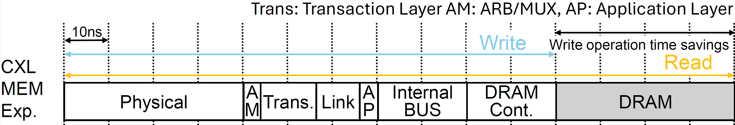
Why write is faster than read ?
For write operations, when write data arrives at the memory (DRAM) controller, it can be buffered, allowing the controller to send the host that the write command is complete.
However, for read operations, the controller must retrieve the read data from memory (DRAM) and deliver it to the host before the read command can be considered complete.
Write
Read
- The path taken during read and write operations.
- Analysis of the execution time of read and write commands within the device.
10
Notes:
1. Explanation of Write vs. Read Latency
"This slide explains why write operations are faster than read operations on the CXL memory expander."
2. Write Operation Process
"For write commands, when data reaches the memory controller, it can be buffered immediately."
"This allows the controller to signal completion to the host without waiting for the data to be fully stored, shortening the write path and reducing latency."
3. Read Operation Process
"In contrast, for read operations, the controller must retrieve the requested data from memory and send it back to the host before the read command is considered complete."
4. Additional Step in Read Path
"This extra step in the read process results in longer latency compared to writes."
5. Diagram Explanation
"The diagram illustrates these paths, showing how the write path is more direct, while the read path requires additional travel steps."
"This difference in paths explains the observed performance gap between write and read operations."

Slide 12
Discussion – Optimization Strategies
Possible Improvements:
  Optimize command transmission latency
    The wire delay in PCIe is a significant factor, and reducing the physical distance between the CPU and the device can minimize this latency. However, in server environments, it is often unavoidable to have some physical distance between connected devices.
  Reducing the command processing time within the device
    This may involve optimizing the internal architecture and logic to handle commands more efficiently.
  Prefetch data for anticipated reads
    By preparing data in advance, the device can reduce idle cycles and enhance overall system responsiveness.
  On-device Cache
    Introduce an L4-level cache inside the CXL memory controller to cache read data.
11
Notes:
1. Overview of Optimization Strategies
"This slide covers potential optimization strategies to improve the performance of the CXL memory expander."
2. Optimizing Command Transmission Latency
"First, we can optimize command transmission latency by reducing the physical distance between the CPU and the device."
"This is important because wire delay on the PCIe interface has a significant impact on latency."
"However, in server environments, minimizing this distance can be challenging."
3. Reducing Command Processing Time
"Another strategy is to reduce command processing time within the device by optimizing its internal architecture and logic."
"This would allow the device to handle commands more efficiently."
4. Prefetching Data for Anticipated Reads
"Prefetching data for anticipated reads can also help by preparing data in advance."
"This reduces idle cycles and enhances system response."
5. Introducing an On-Device Cache
"Lastly, we could introduce an on-device cache, such as an L4-level cache, within the CXL memory controller."
"This would store frequently accessed read data, further reducing access times and improving overall performance."

Slide 13
Conclusion
Summary
  CXL provides scalable memory but introduces latency, especially for reads.
Necessary to implement optimizations for high-performance applications.
Future Work
  Further optimizations for CXL memory expanders in complex workloads.
12
Notes:
1. Summary of CXL Benefits
"In conclusion, CXL technology provides a scalable solution for memory expansion."
"This makes it a valuable option for systems that require high memory capacities."
2. Latency Challenge
"However, our results show that CXL introduces additional latency, particularly for read operations."
"This added latency can affect performance in applications where low latency is critical."
3. Need for Optimization
"These findings highlight the need for further optimization strategies to reduce latency and improve efficiency."
4. Future Work
"Future work will focus on developing and implementing these optimizations, especially for complex workloads with high performance demands."
5. Vision for CXL Memory Expanders
"With these enhancements, CXL memory expanders can become even more effective in supporting high-performance computing environments."

Slide 14
Q & A
Thank you!
13

